Slide 2

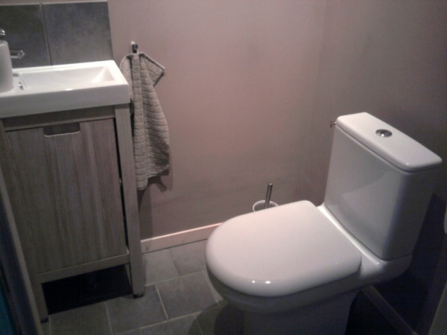
Wyre Scouts – District Development Day
      Health & Safety - General

Slide 3
      Coming Up Tonight
District Updates
Awards Presentations
Transforming Our Volunteer Experience
Q&A

Slide 4
District Updates

Slide 5
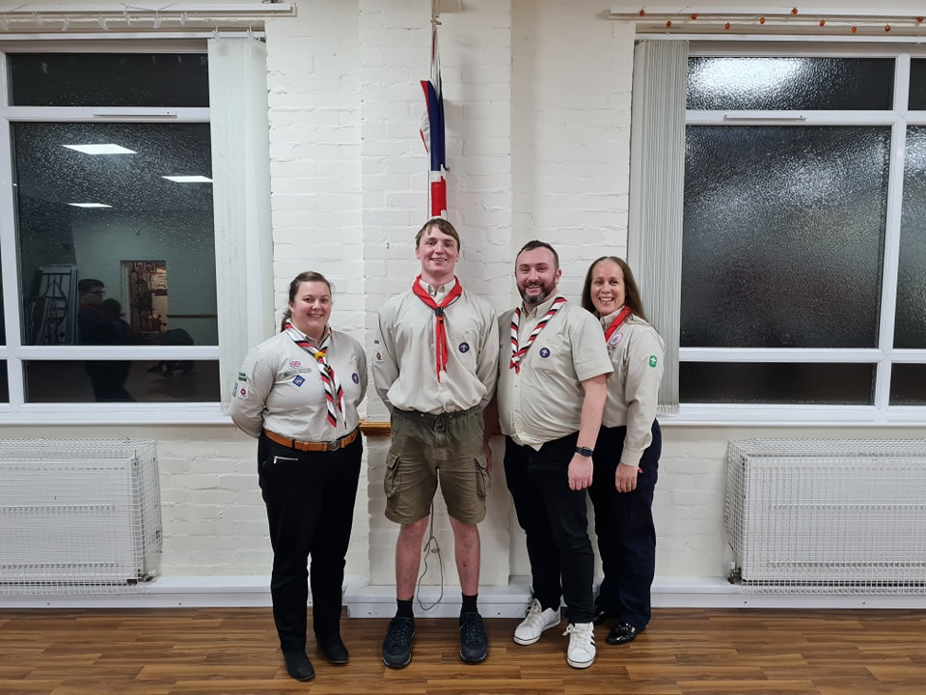
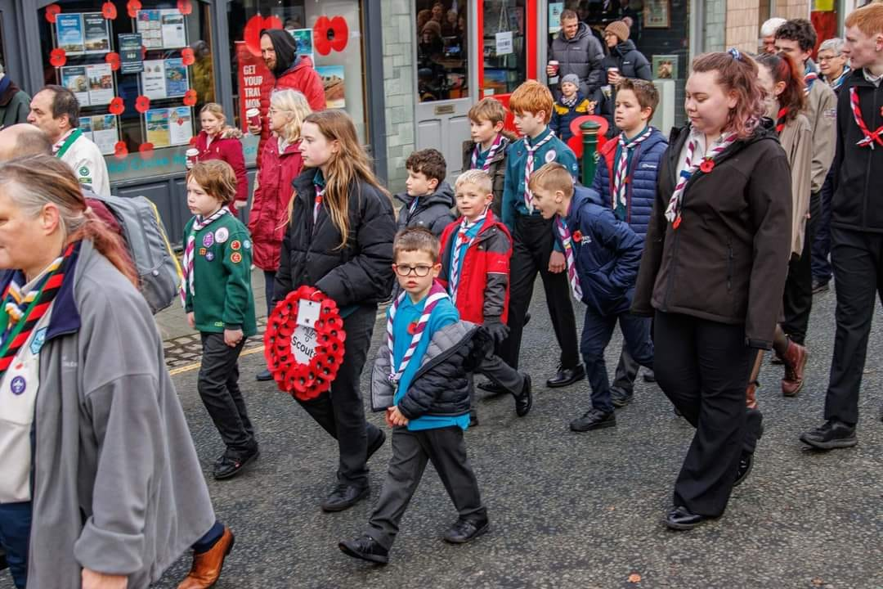
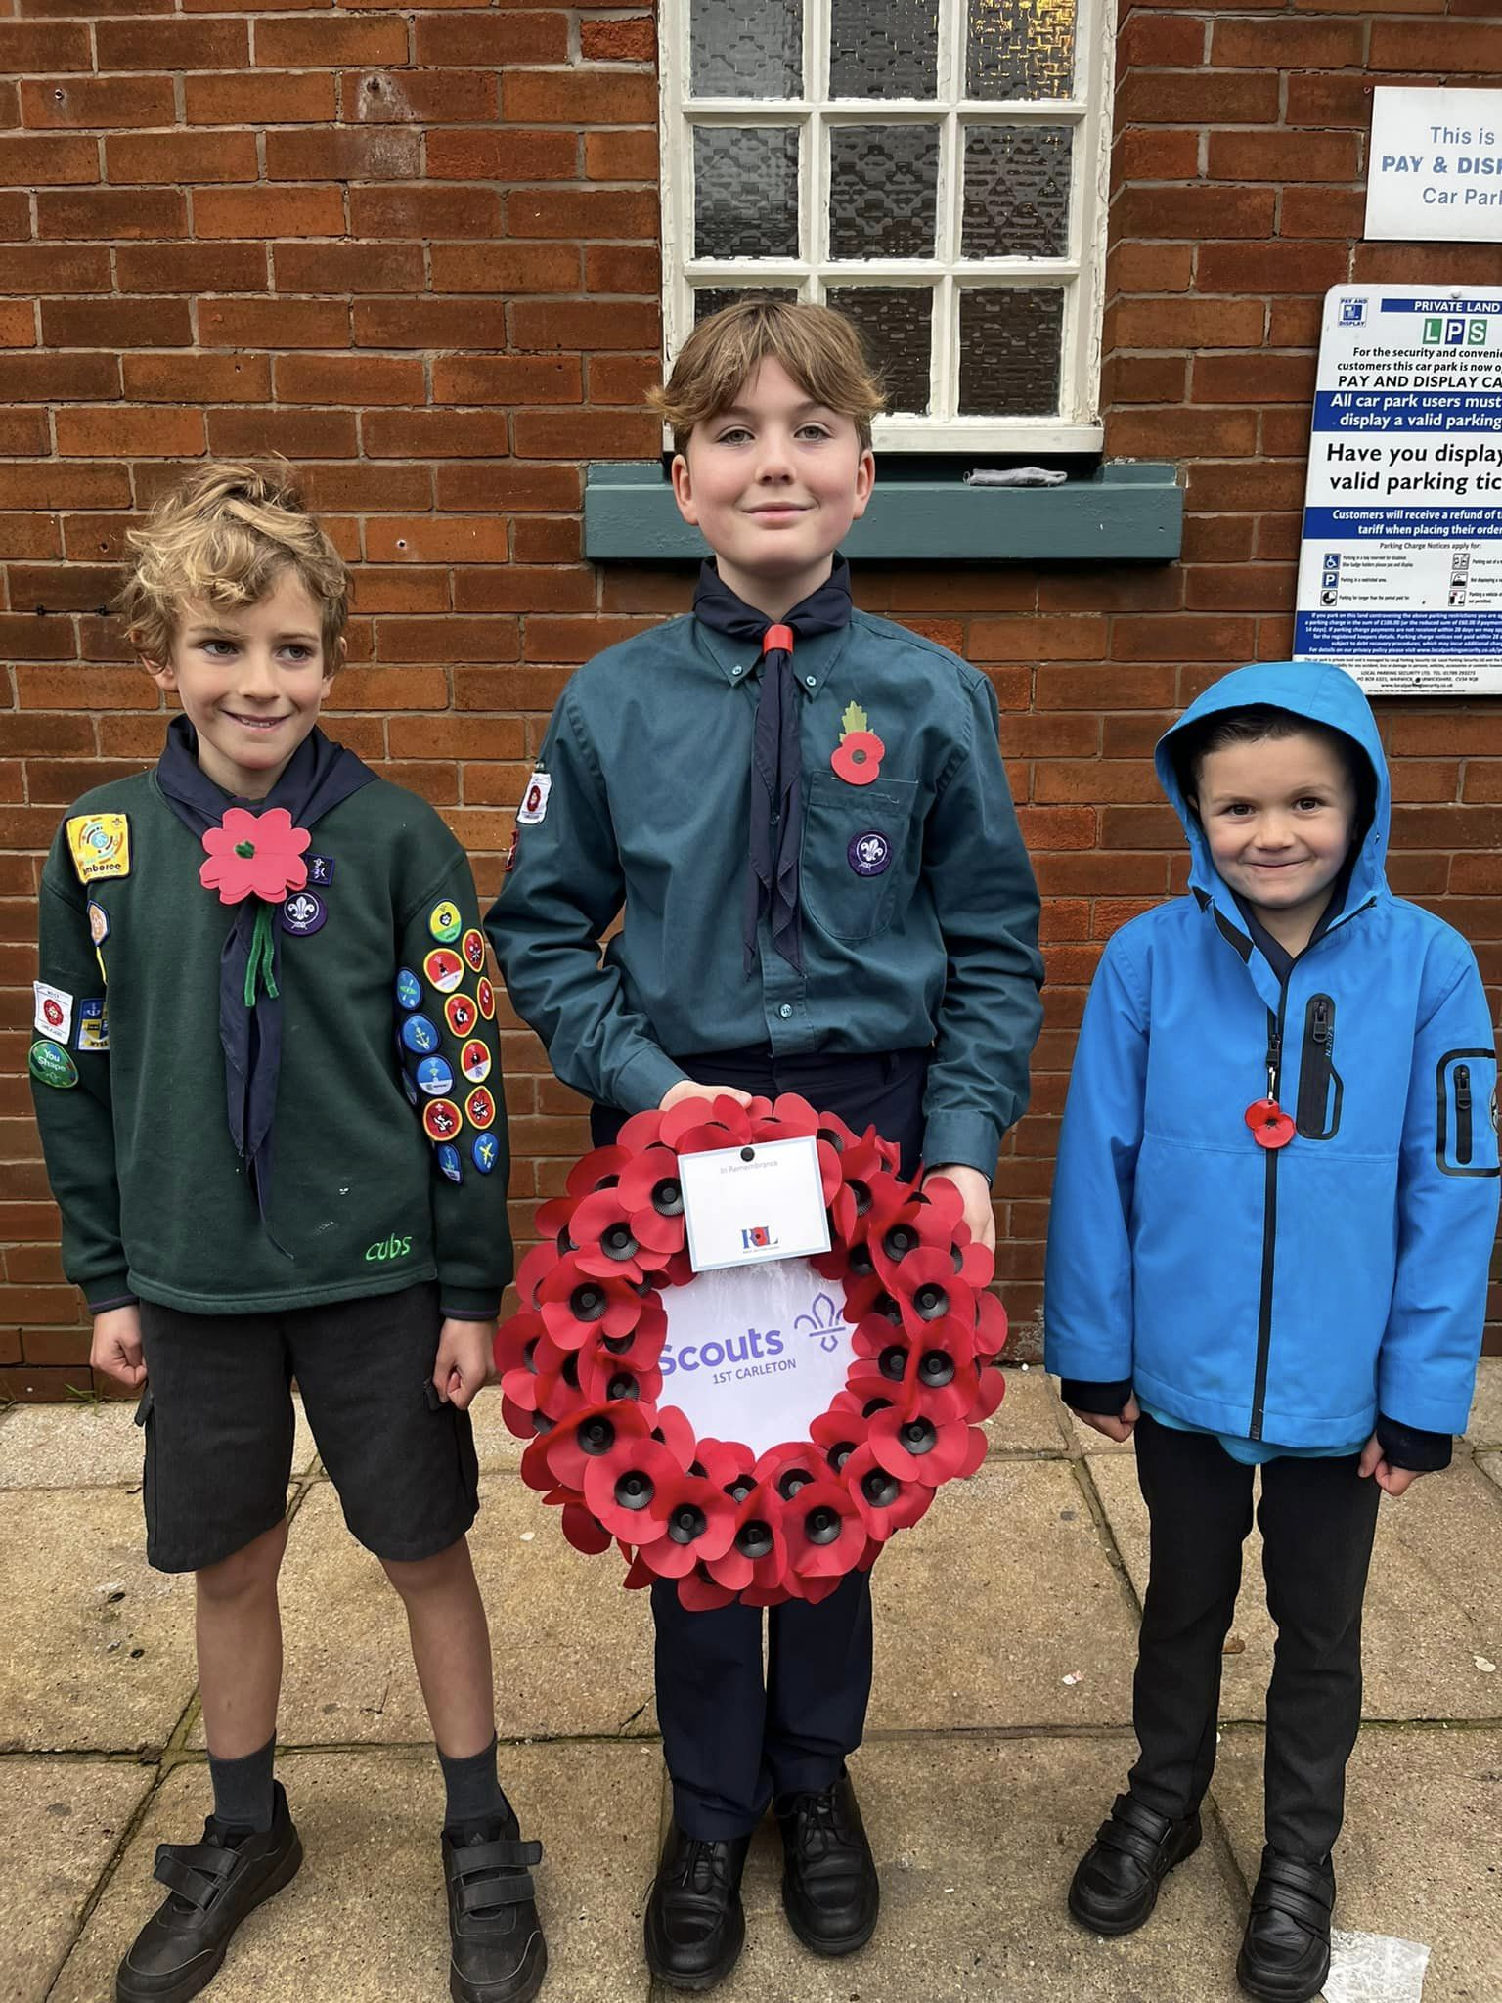
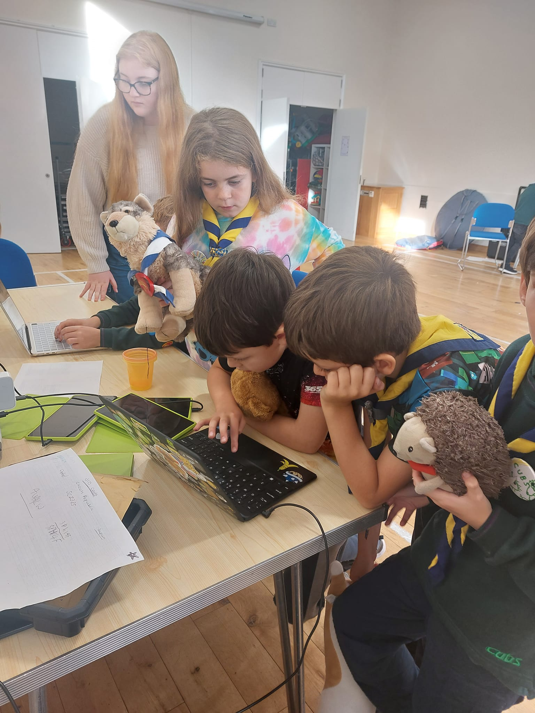
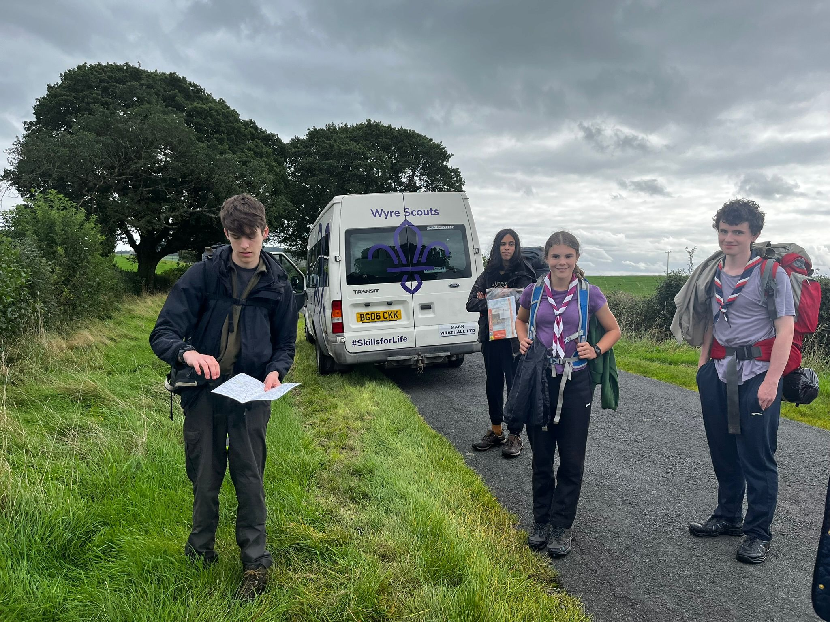
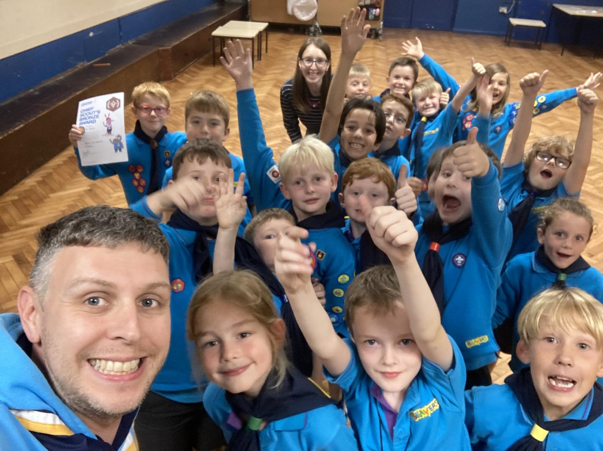
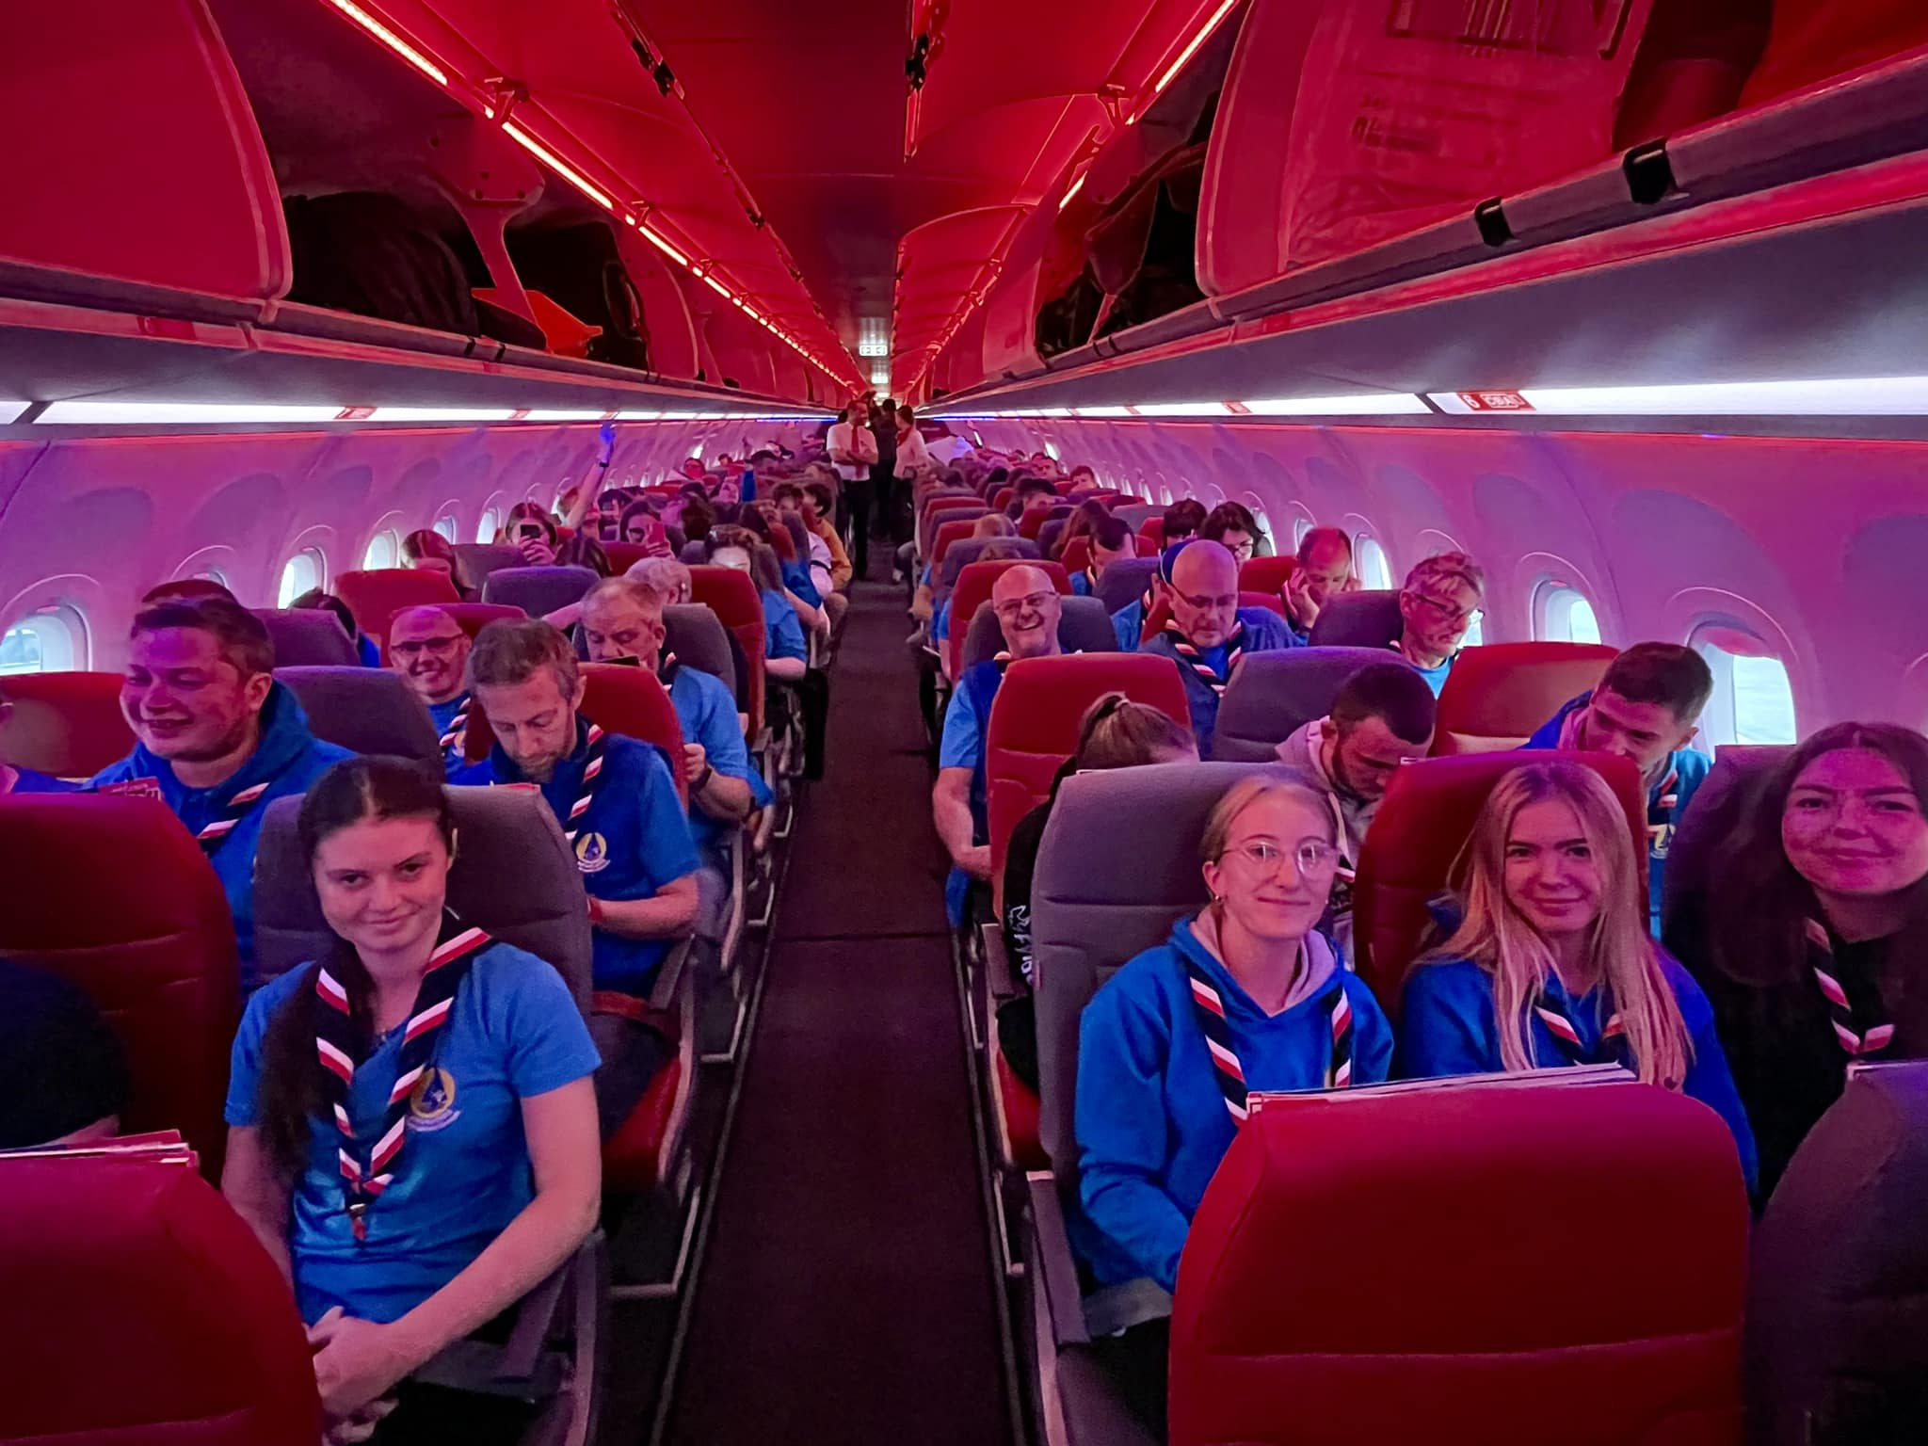
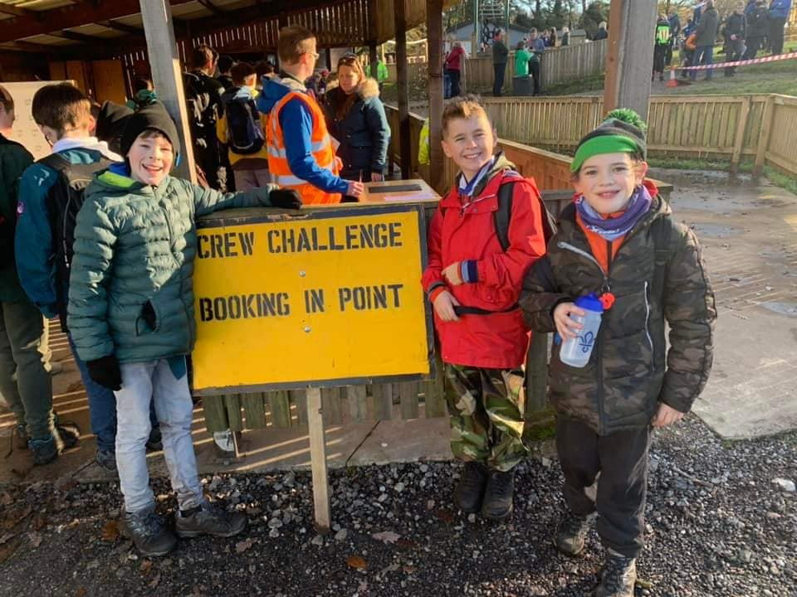
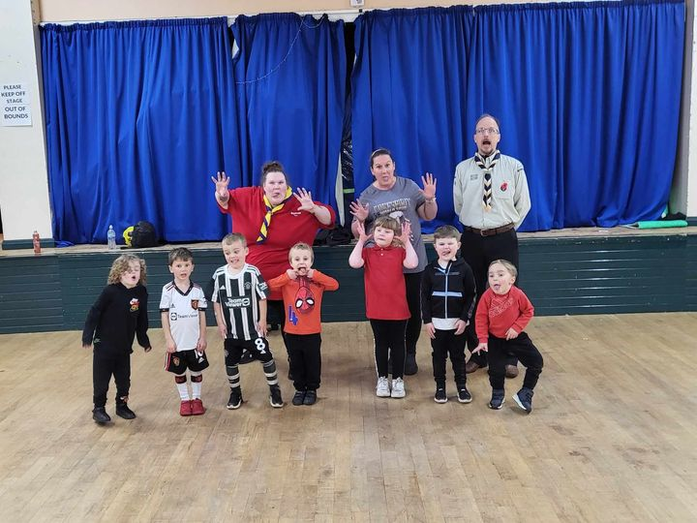
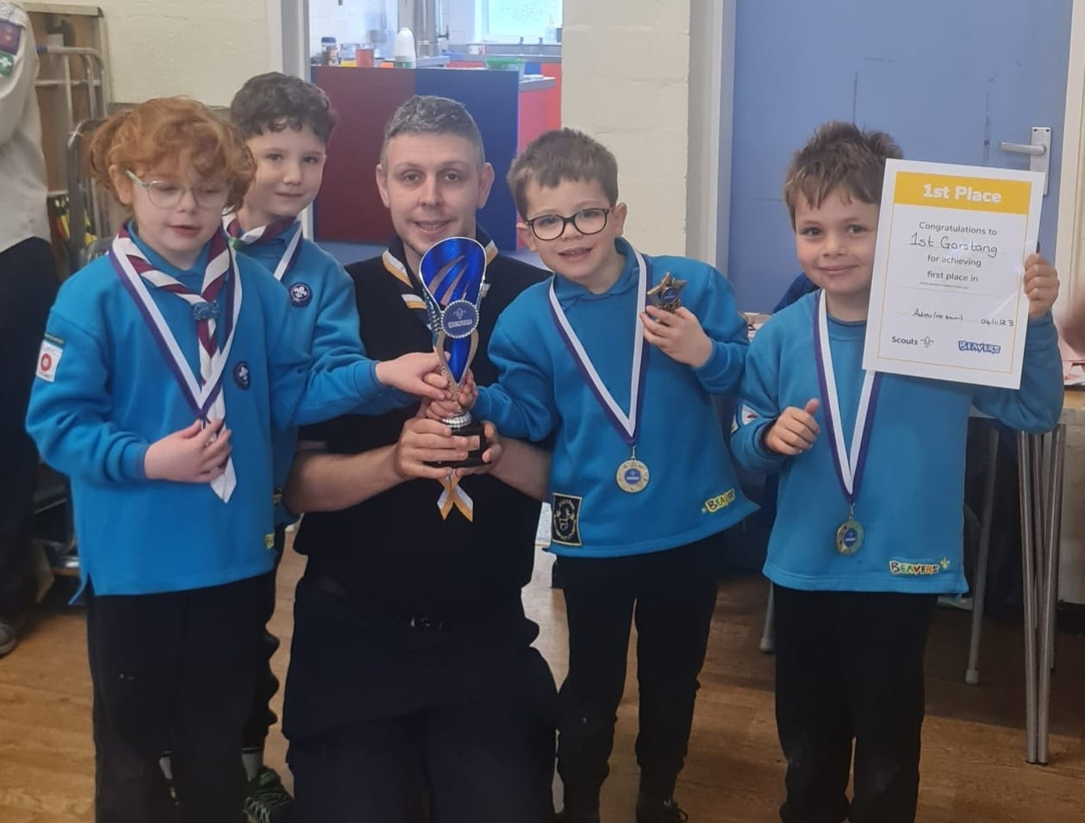
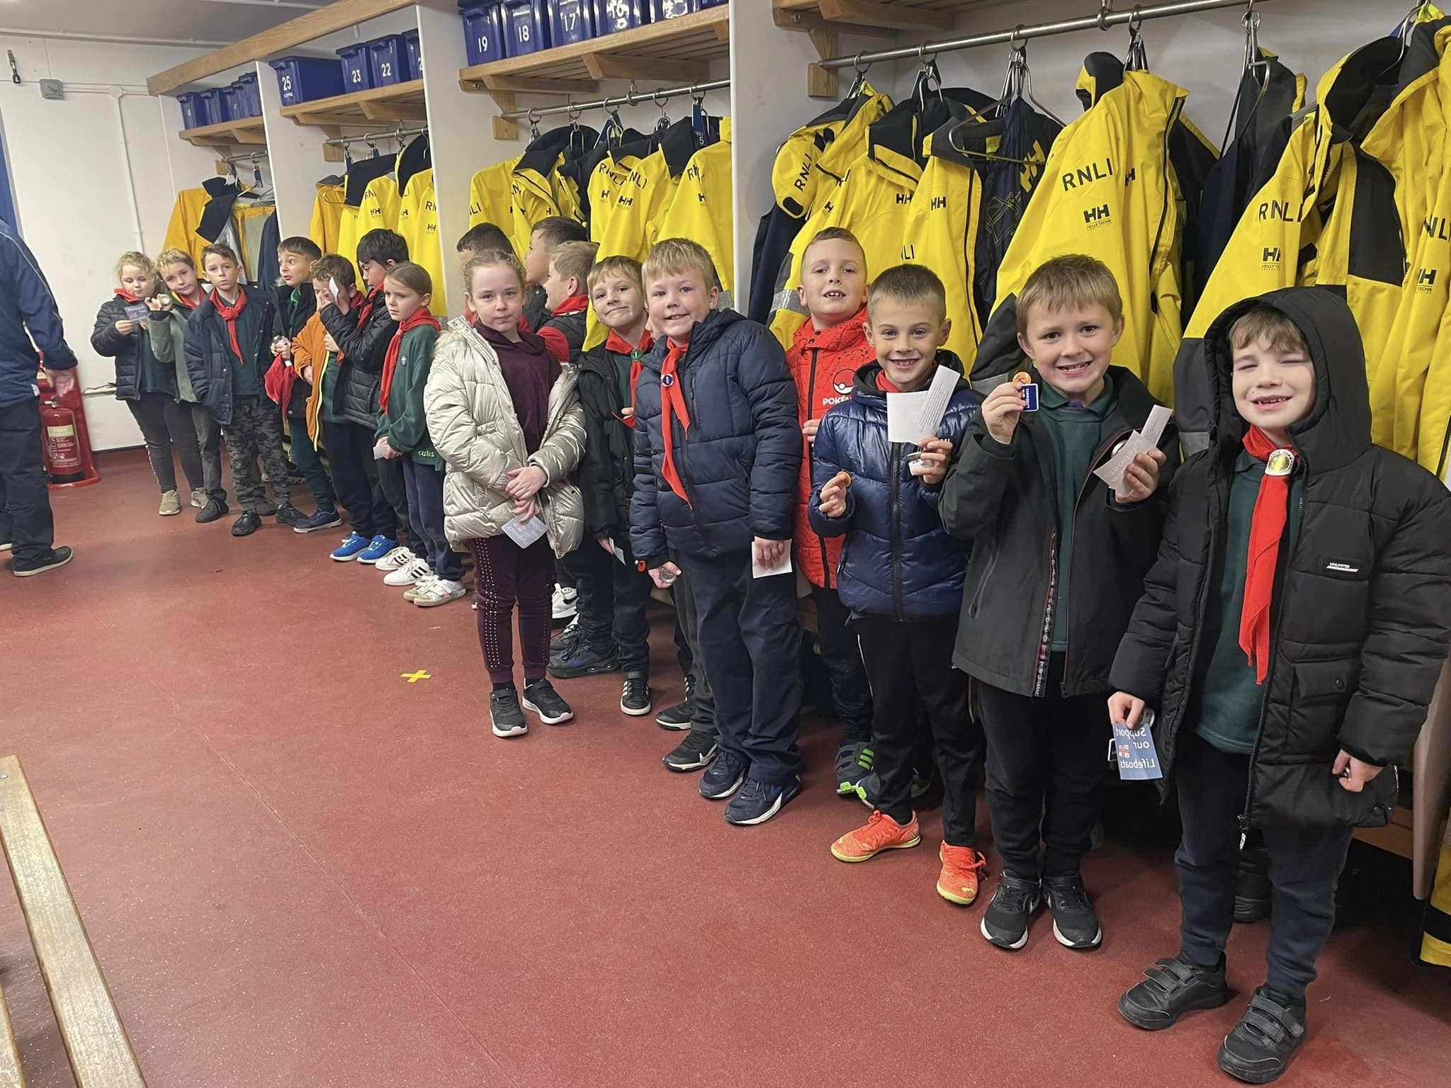
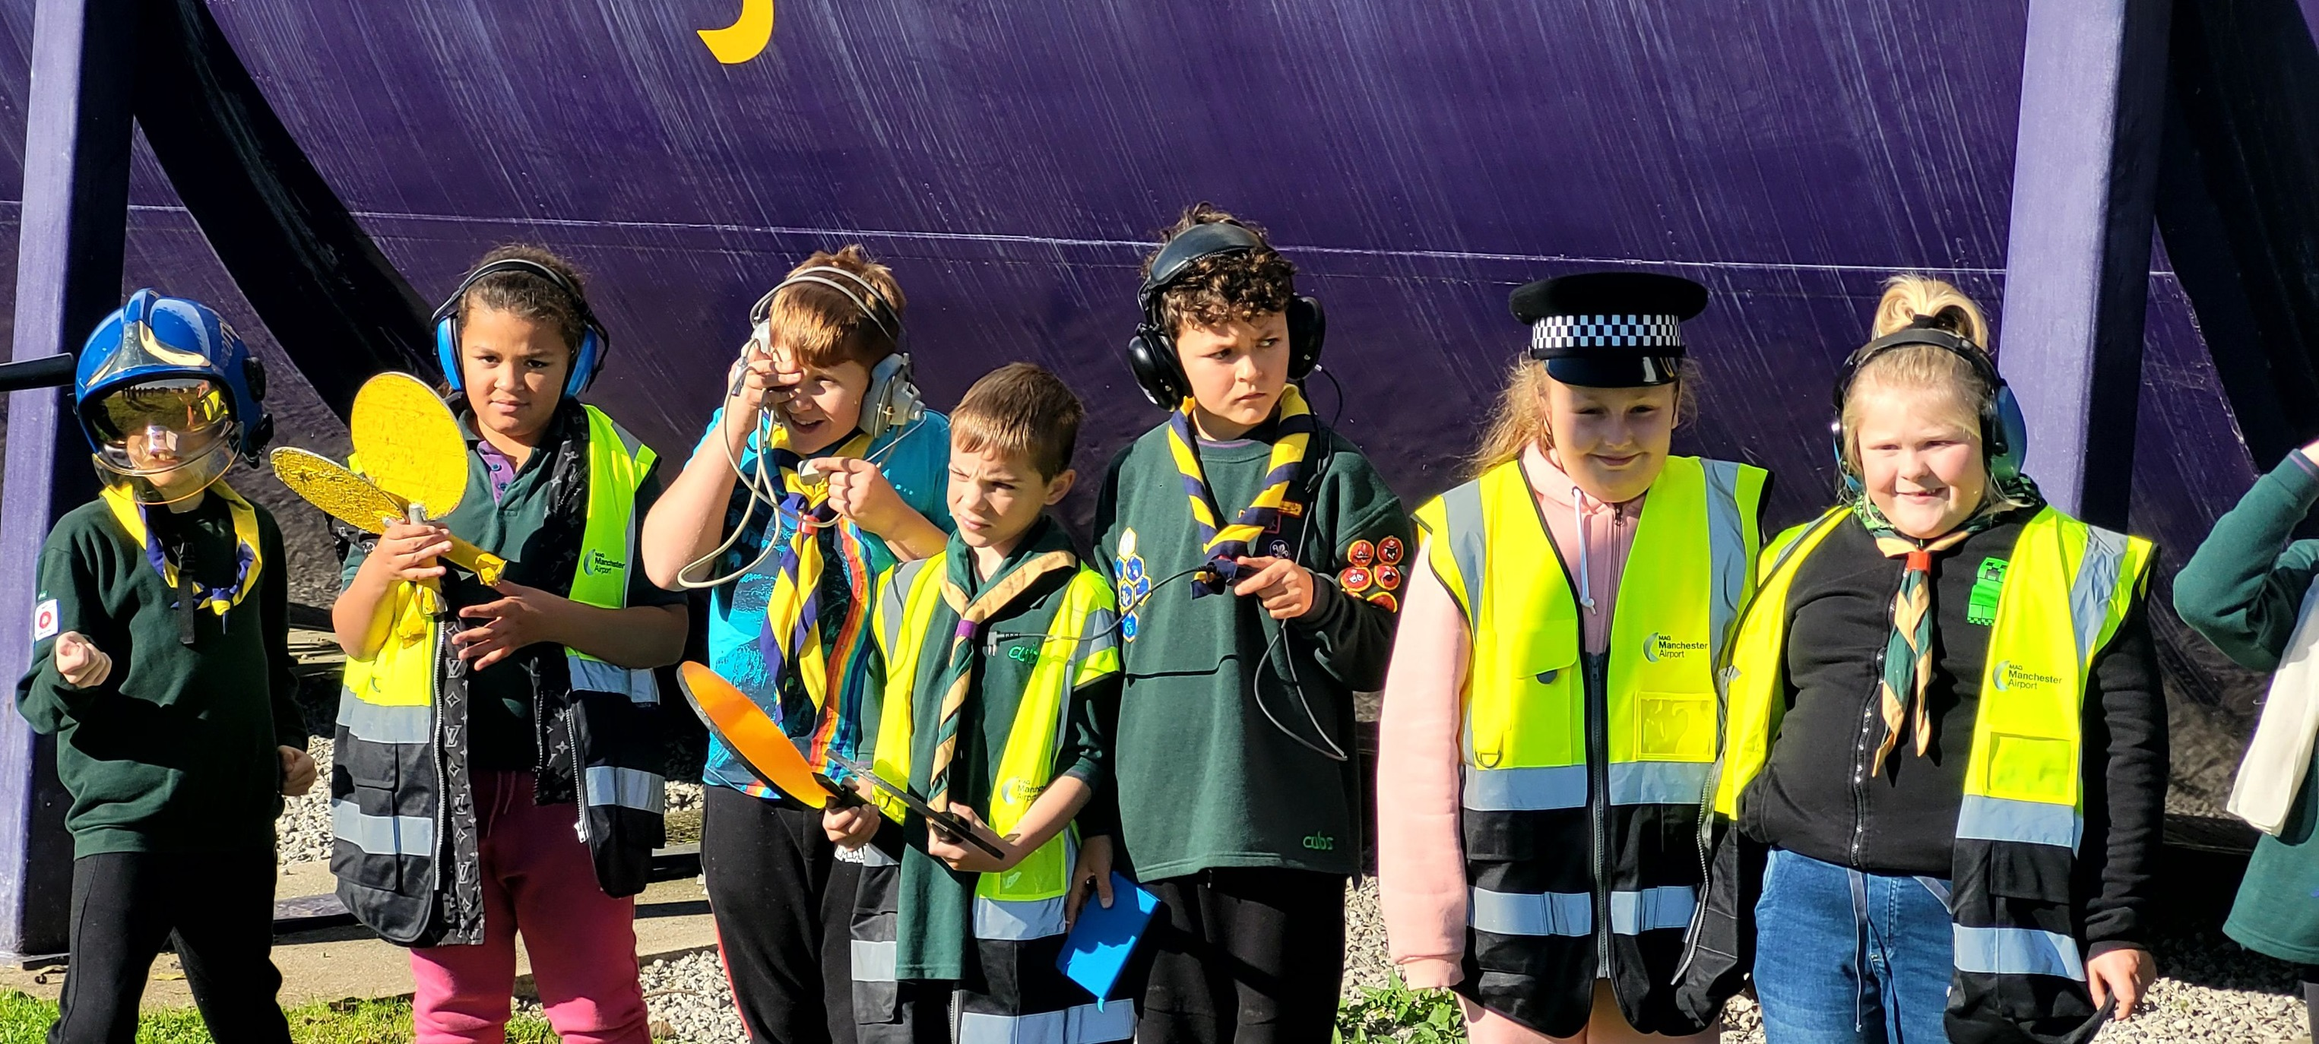
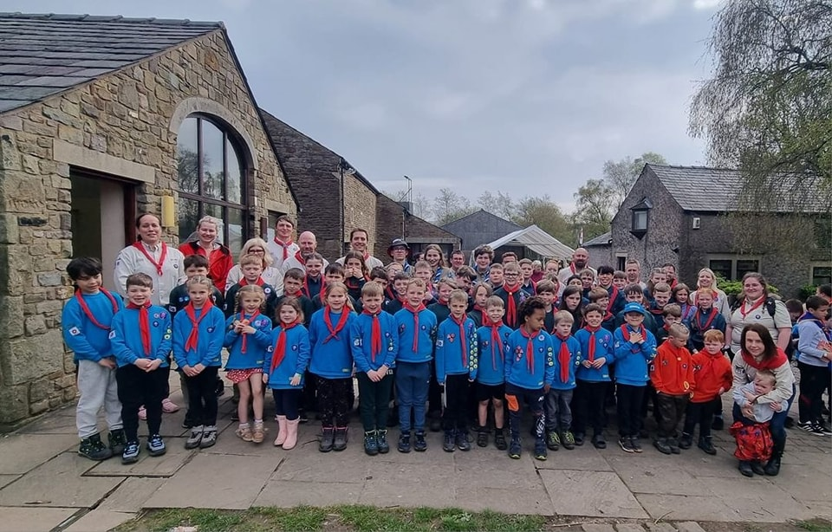
      What Have We Been Up To…?

Slide 6
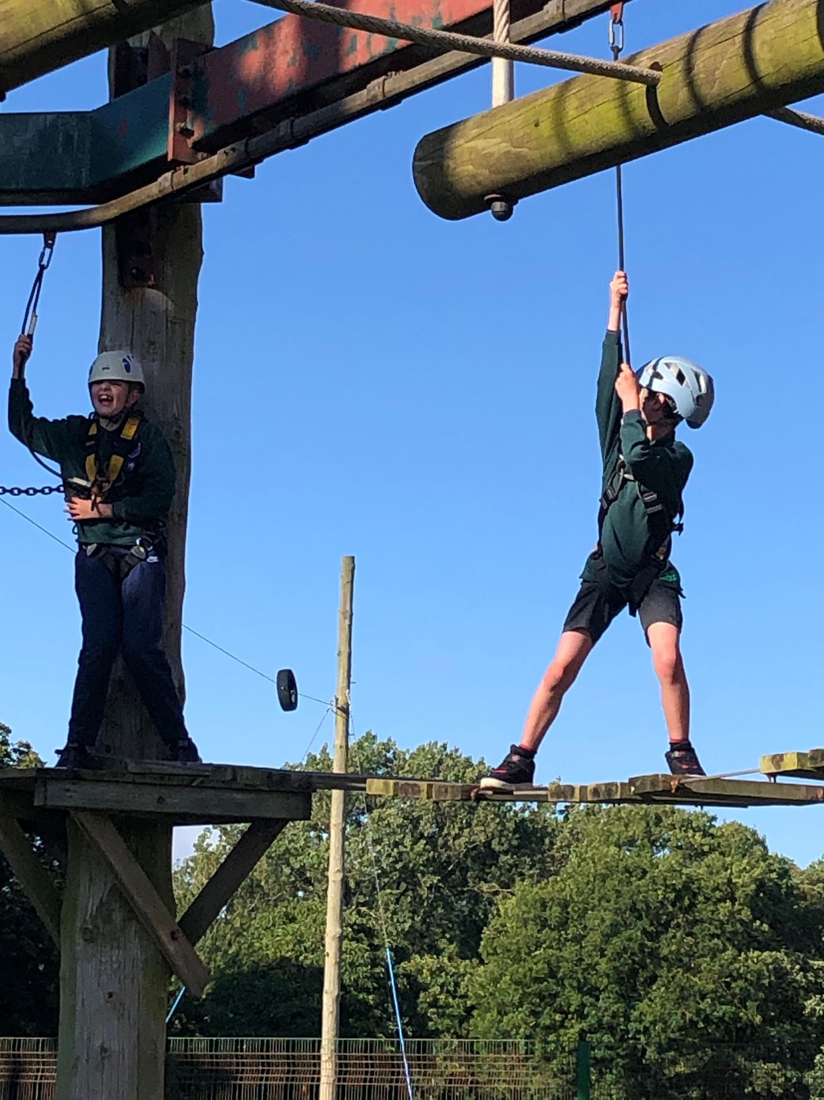
      Growth & Development
We have much to celebrate this year with our District growing, new volunteers joining and more young people accessing Scouting!
We will soon have 7 Squirrel Dreys!
We have opened new sections!
Volunteers are joining us!
We still have waiting lists across the district. How can we enable these young people to join Scouting?

Slide 7
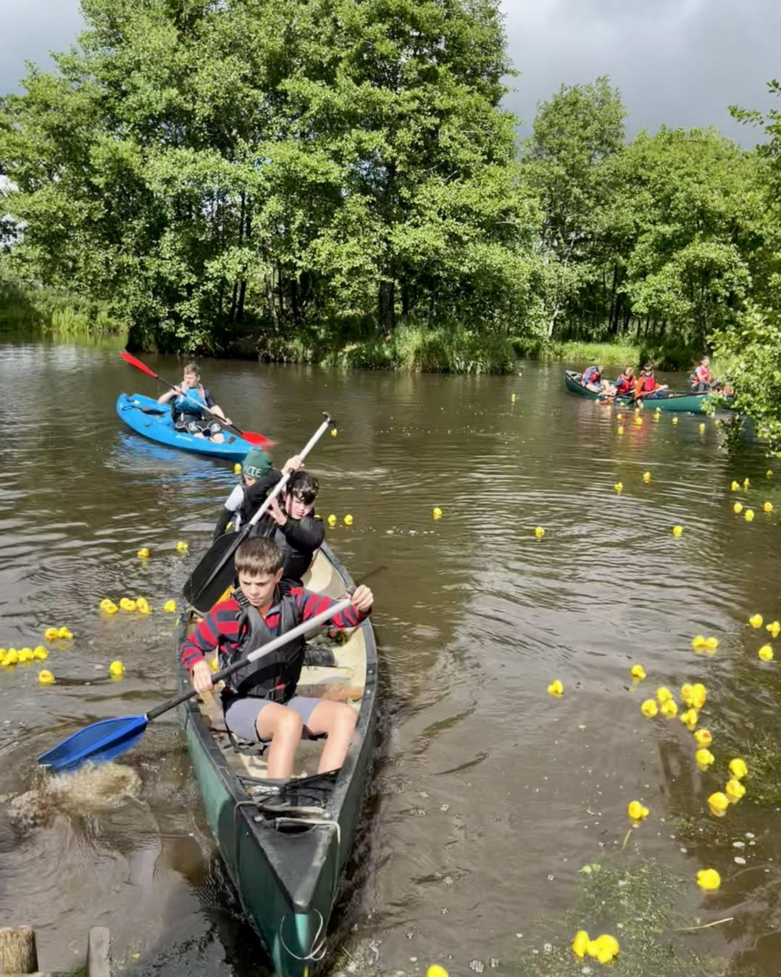
      Programme Team Updates – District Camp
26th – 28th April – Waddecar Scout Activity Centre
Highlight of the District Calendar!
Open to all members, Squirrels, Beavers, Scouts, Explorers, Network, Volunteers….

Slide 8
  Award Presentations

Slide 9
Plan for who presents what
Section | Slides | Presenter
Intro | 1-10 | Transformation Lead | Andrew
What’s changing | 11-13 | DC | Jon
Simplifying how we volunteer together | 14-17 | DC | Jon
Role titles | 18-23 | Support TL | Ulric
Team Based Approach | 24-38 | Programme TL | Jan & Jon
Warmer Welcome | 39-42 | Volunteering Dev TL | Caroline
More Engaging Learning | 43-52 | Volunteering Dev TL | Caroline
Culture | 53-54 | 14-24 TL | Nicky
Being Prepared | 55-56 | 14-24 TL | Nicky

Slide 10
Transforming our Volunteer Experience

Slide 11

Transforming our Volunteer Experience
Introduction
Purpose
  To give an overview of the upcoming changes, covering;
  Why we’re transforming volunteering
  What is changing?
    A warmer welcome for everyone
    More engaging learning
    How we volunteer together
  How is this being delivered?

Slide 12
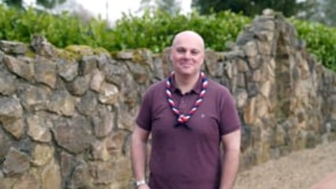

Slide 13
Transforming our Volunteer Experience
Why we’re transforming volunteering

Slide 14
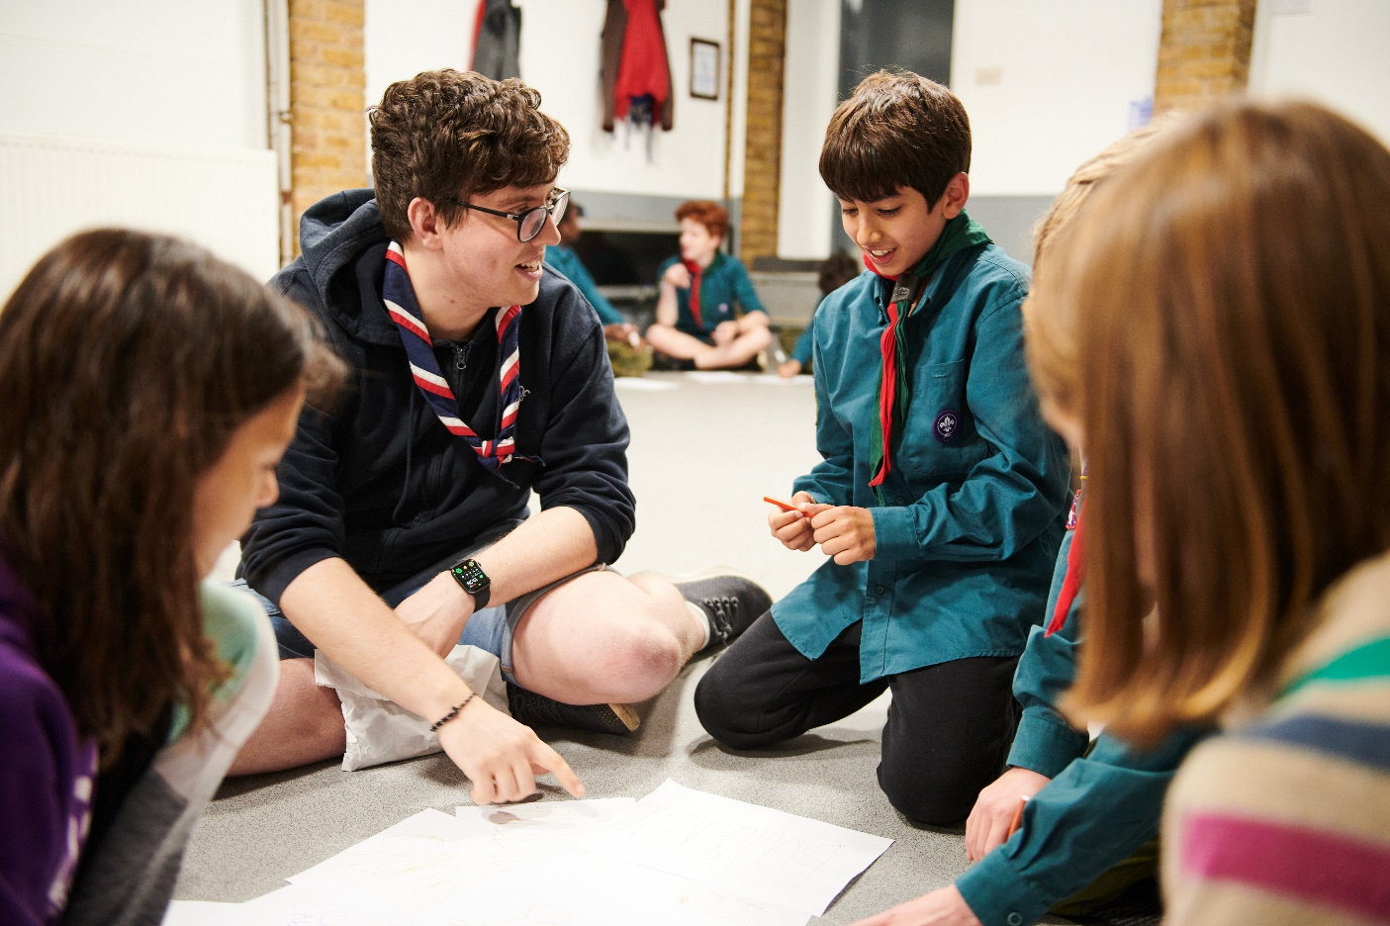
Transforming our Volunteer Experience
Why we’re transforming volunteering
Why we’re transforming volunteering
Our Skills for Life strategy
To provide more young people, and the ones we already have, with skills for life, we need more volunteers
Every volunteer deserves to feel valued during their time with Scouts
The world is changing, and volunteers want more flexibility in the time they give
Ultimately…..

Slide 15








Transforming our Volunteer Experience
Why we’re transforming volunteering
We want to make volunteering with Scouts easier and more fun…
…so that we can attract more volunteers and our current volunteers want to stay

Slide 16



Making volunteering easier and more fun is how we reach our North star...
More young people gaining skills for life
Consistently and safely
deliver a great programme
Recruit more volunteers
and retain current ones

Slide 17
Transforming our Volunteer Experience
Why we’re transforming volunteering
Throughout 2019 and 2020 we spoke to…
All volunteers invited to have their say
Over 5,000 so far
All UK nations
Young People
Those we want to welcome into scouting
Wide range of backgrounds and communities
Members of the public
British Scouting Overseas
Groups and sections
Volunteers who’ve left us
Other volunteering organisations
Volunteer managers

Slide 18
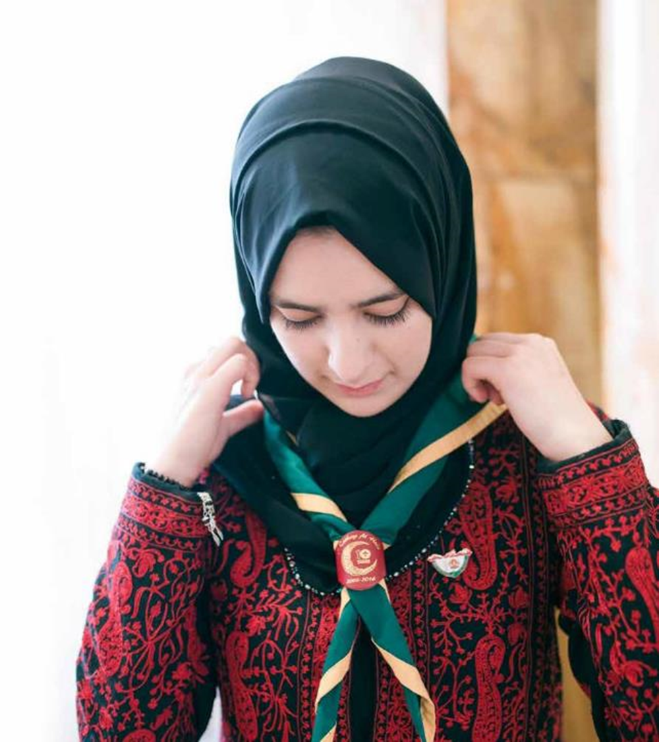
Transforming our Volunteer Experience
Why we’re transforming volunteering
What did we learn?
Leaders deeply enjoy volunteering and providing young people with skills for life
However, challenges to this still exist:
Only 30% of potential volunteers want to give time regularly
Current volunteers spend lots of time carrying out administrative tasks
Some of our current processes, role structures and training doesn’t support easier recruitment of new volunteers

Slide 19
Transforming our Volunteer Experience
Why we’re transforming volunteering
We cannot grow to meet our ambitions for young people, from section level to the whole of the UK, without making some fundamental changes

Slide 20
Transforming our Volunteer Experience
What is changing?

Slide 21
Transforming our Volunteer Experience
What is changing?
Listening to our volunteers, young people and more we’ve identified three key areas for change:
Providing a warmer welcome for everyone
Delivering a more engaging learning experience
Simplifying how we volunteer together
All of which will be supported by easy-to-use digital tools

Slide 22
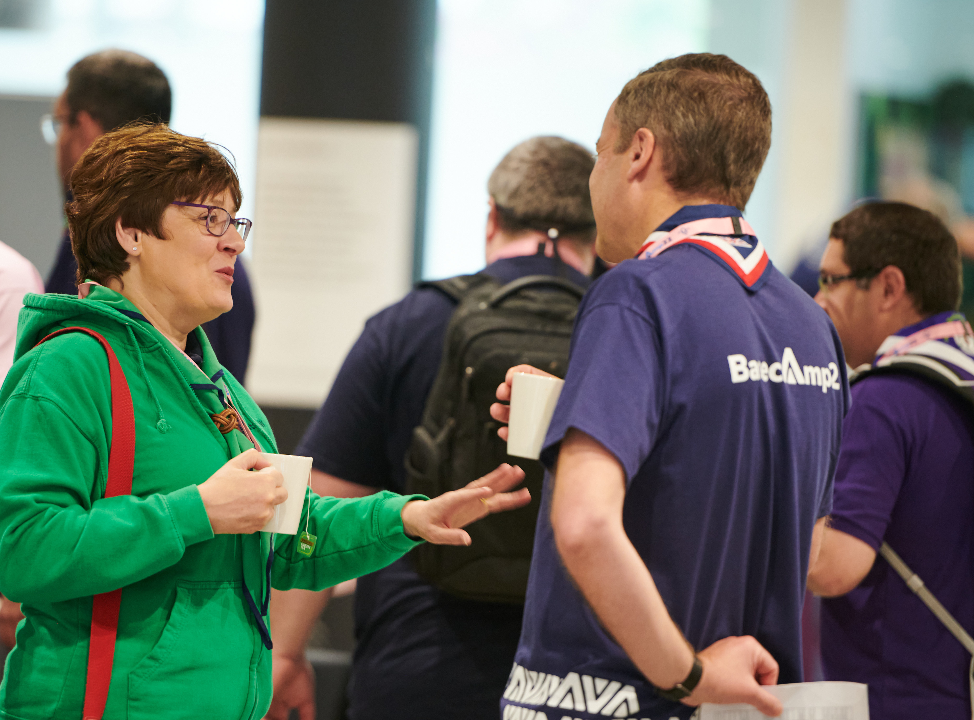
Transforming our Volunteer Experience
What is changing?
How are we designing the changes?
Ensuring these changes practically support our volunteers is extremely important. To that end we have:
Volunteers leading alongside staff on each area of change
A volunteer experience group, open to all our volunteers, to help shape the changes
The digital membership testing group, open to all our volunteers, to help test and shape our digital tools
An early adopter cohort of 10 different areas across the UK who will go first with the changes and help to shape the resources and support available

Slide 23
Transforming our Volunteer Experience
Simplifying how we volunteer together

Slide 24
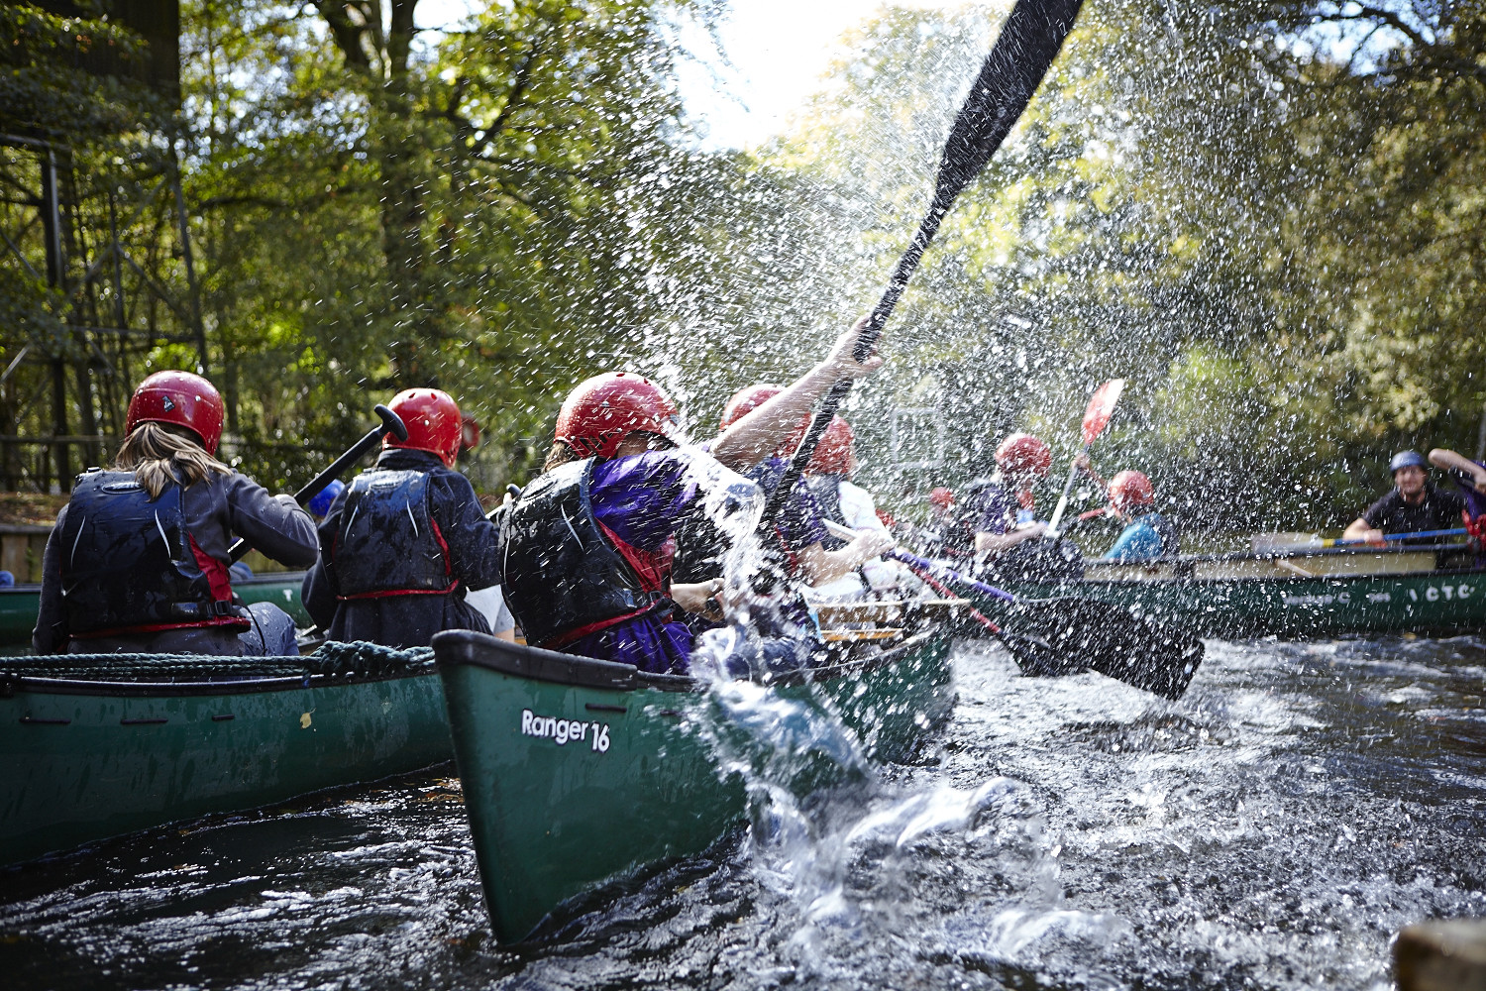
Transforming our Volunteer Experience
Our Volunteer Journey
What have we learnt?
In our research with volunteers, we have learnt that:
We have too many roles, these are often fixed and can feel like work
New volunteers find it hard to understand the expectations of different roles which can put them off joining
We have a small number of people/roles with lots of responsibility and stress placed on them
The digital systems which manage volunteers are inefficient and time consuming to use

Slide 25
Transforming our Volunteer Experience
Our Volunteer Journey
What’s changing?
From | To
Individual, inflexible and fixed roles | Volunteers working in teams, on tasks with a clear purpose
Unclear expectations for new and current volunteers | Clearer roles with titles that people inside and outside Scouting understand
A small number of people/roles with lots of responsibility and stress | Improved team structures with clearer responsibilities, new digital systems to reduce administration
Ineffective and time-consuming digital systems for volunteers | New digital easy-to-use systems to support volunteers and volunteer managers
Volunteering can feel like work | Structures and teams which allow for individuals to contribute in a way that matches their skills, interests and availability

Slide 26
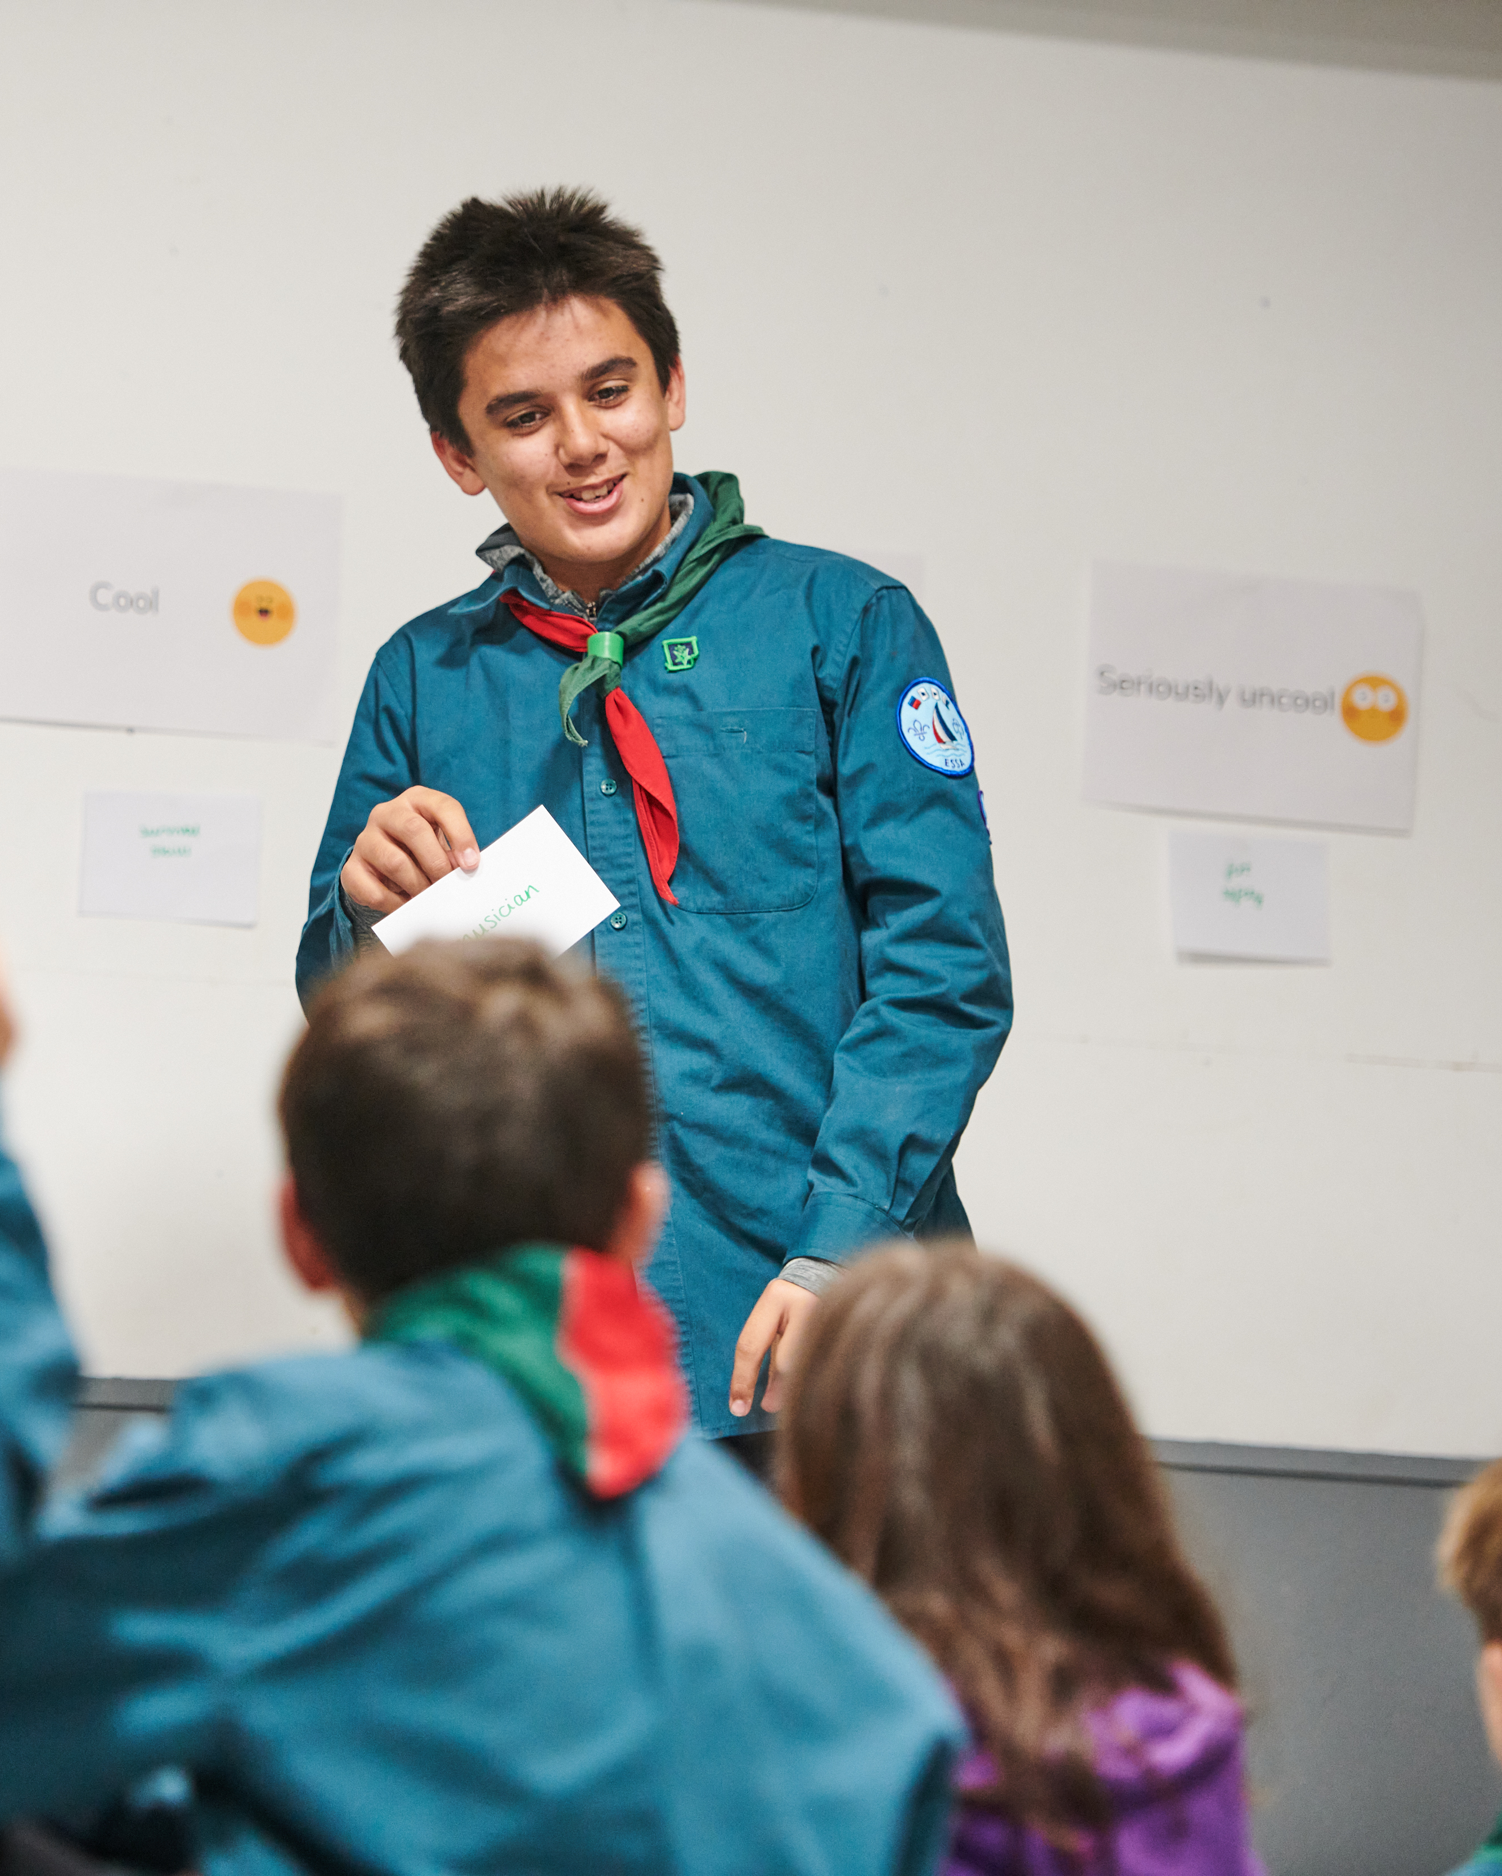
Transforming our Volunteer Experience
Our Volunteer Journey
Digital systems supporting this change
A new membership system will form part of the new digital system supporting this change. Features include:
Easier and improved management of
  Volunteer Roles
  Permits
  Awards
  Nights Away Notifications
Additional features added over time

Slide 27
How we Volunteer Together
Changing our role titles

Slide 28
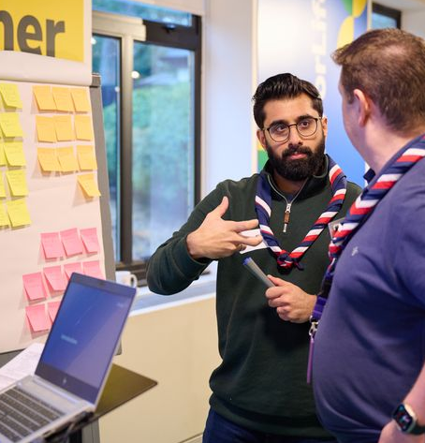
How we Volunteer Together
Changing our role titles
Changing our Role Titles
The volunteer experience changes being made are part of transforming our culture within Scouts
It’s important that we recognise how our role titles are part of both our culture and our perception as a movement
We’re changing many of our role titles within Scouts to:
Reflect on our perception outside of Scouts
Provide a consistent and clear structure across our leadership roles
Make our roles and responsibilities clearer
Make it easier to share tasks within a team
Set out what we want our culture to be

Slide 29

How we Volunteer Together
Changing our role titles
Changing our Role Titles
We currently have over 400 role titles, which can make our structure difficult to understand and remain consistent
As part of changing how we volunteer together we’re simplifying our role structures and role titles
We’ll be introducing Team Leader and Team Member role titles as part of this
These titles will replace many of our current roles such as Section Assistant and Assistant Section Leader and more, along with our Deputy and Assistant roles

Slide 30
How we Volunteer Together
Changing our role titles
Those in leadership roles have told us:
Introducing Lead Volunteers
30% of all leadership roles are vacant
It’s important that we have a consistent and clear structure across our leadership roles
We currently find our leadership roles some of the hardest to recruit for, in part due to their high levels of workload and perception both internally and externally
From research and surveys with our current commissioners, volunteers and outside of scouting we’re making changes to our ‘Commissioner’ and Group Scout Leader role titles
53% of District Commissioner and manager roles
45% said their workload was ‘difficult’ or ‘really difficult’
27% of Group Scout Leader roles
Our external research role told us:
Provides leadership and inspiration to other volunteers
The Commissioner title is used in a very different context outside of Scouts
7% said Commissioner
43% said Lead Volunteer

Slide 31
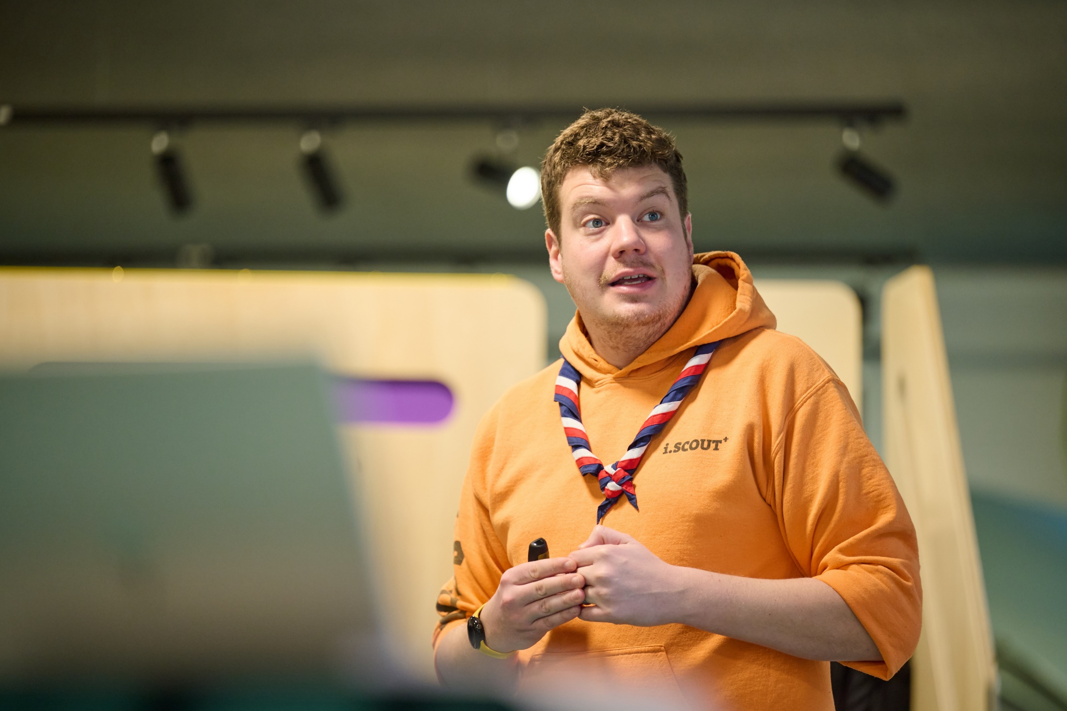
How we Volunteer Together
Changing our role titles
Introducing Lead Volunteers
The ‘Commissioner’ and ‘Group Scout Leader’ titles will change across Scouting
GSLs along with District, County, Area, Region (and so on) Commissioners will be called Lead Volunteers
Youth Commissioners will be called Youth Leads

Slide 32
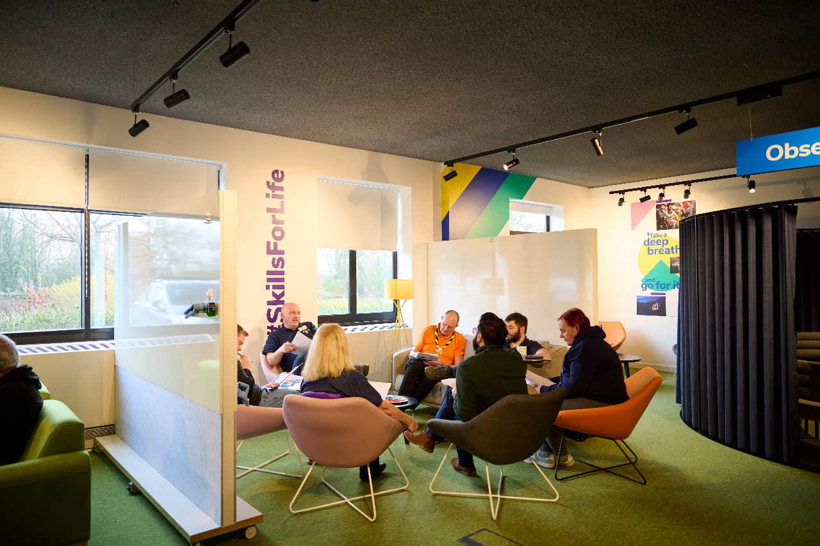
How we Volunteer Together
Changing our role titles
Changing Role Titles
These changes support us to recruit new volunteers and make roles for current volunteers clearer and more flexible and help us to:
Make our roles clearer
Make it easier to share tasks as a team
Support recruitment of new volunteers
These changes are about how we organise ourselves and our teams, but you’re still…
A Scout Leader, Beaver Leader, Skip, Owl, Badger, Akela, Raksha…
That isn’t changing!

Slide 33
How we Volunteer Together
Adopting a team-based approach

Slide 34
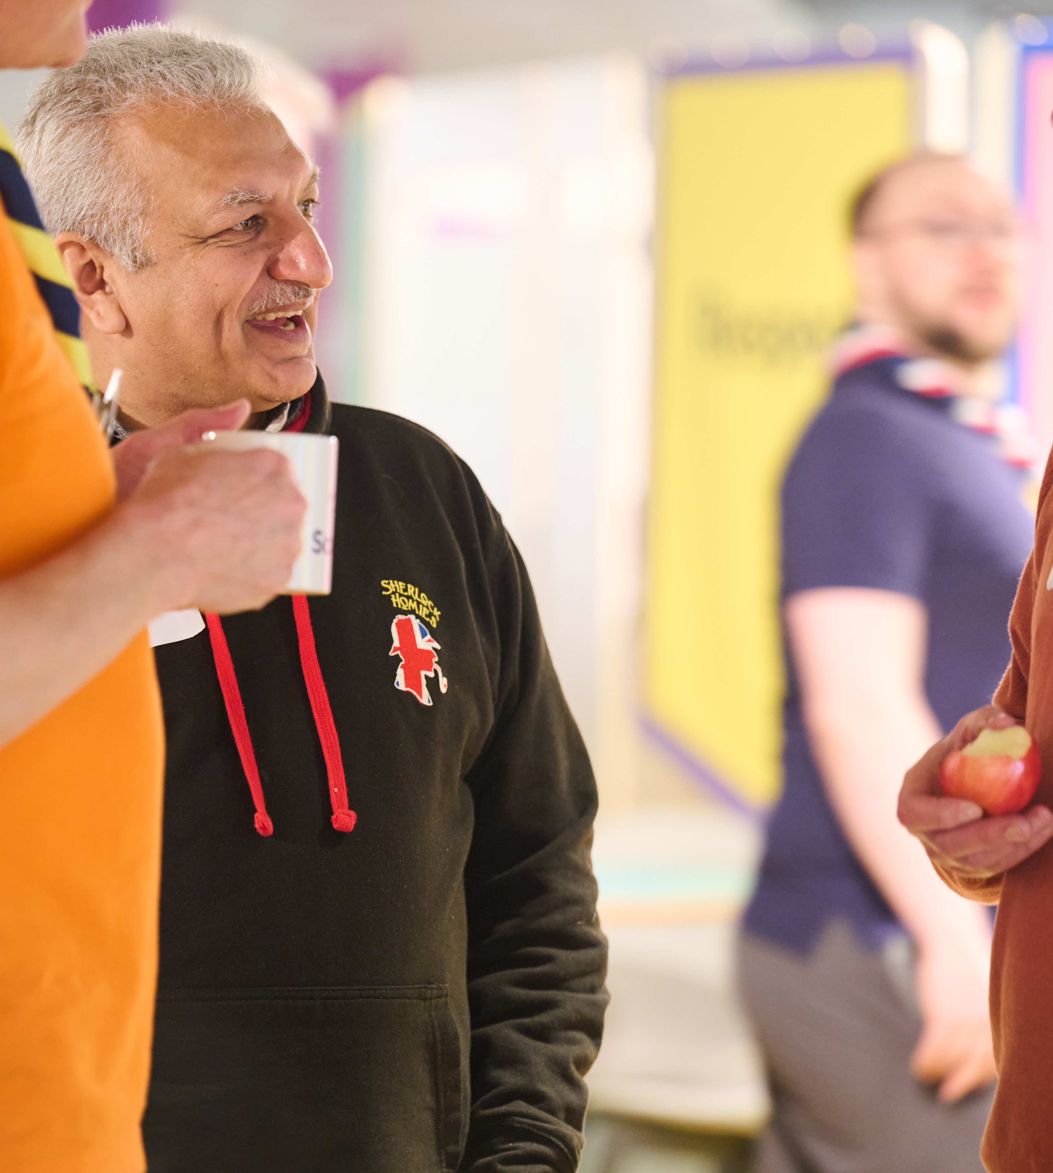
How we Volunteer Together
Adopting a team-based approach
Team-based Approach
Our current approach is heavily roles based, with volunteers often holding multiple different roles within an area
In place of this we’ll have teams and team descriptions
The key principles for this approach are:
We volunteer flexibly as part of a team with a shared purpose
Our teams and titles are easier to understand and more appealing to new volunteers
Teams agree how to share tasks between them, and this can change over time

Slide 35
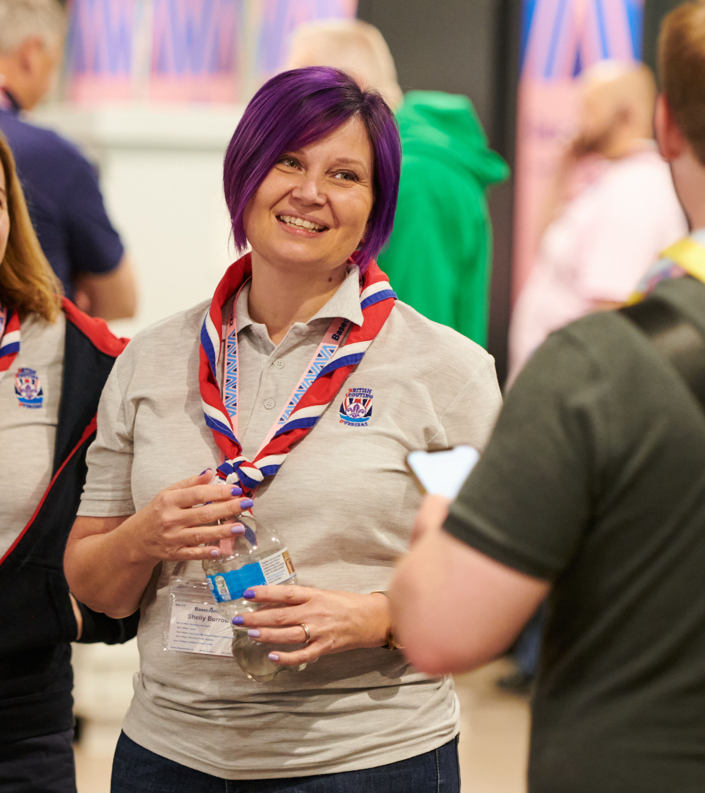
How we Volunteer Together
Adopting a team-based approach
Team Descriptions
Every team description will have:
  Purpose - To explain what the team is for and how it plays a part towards our vision
  Who’s in the team - To explain who is in the team and what they’re called
  Tasks for the whole team - Are things which everyone in the team will be involved with
  Allocated tasks - Are things which are things which can be shared out between members of the team

Slide 36
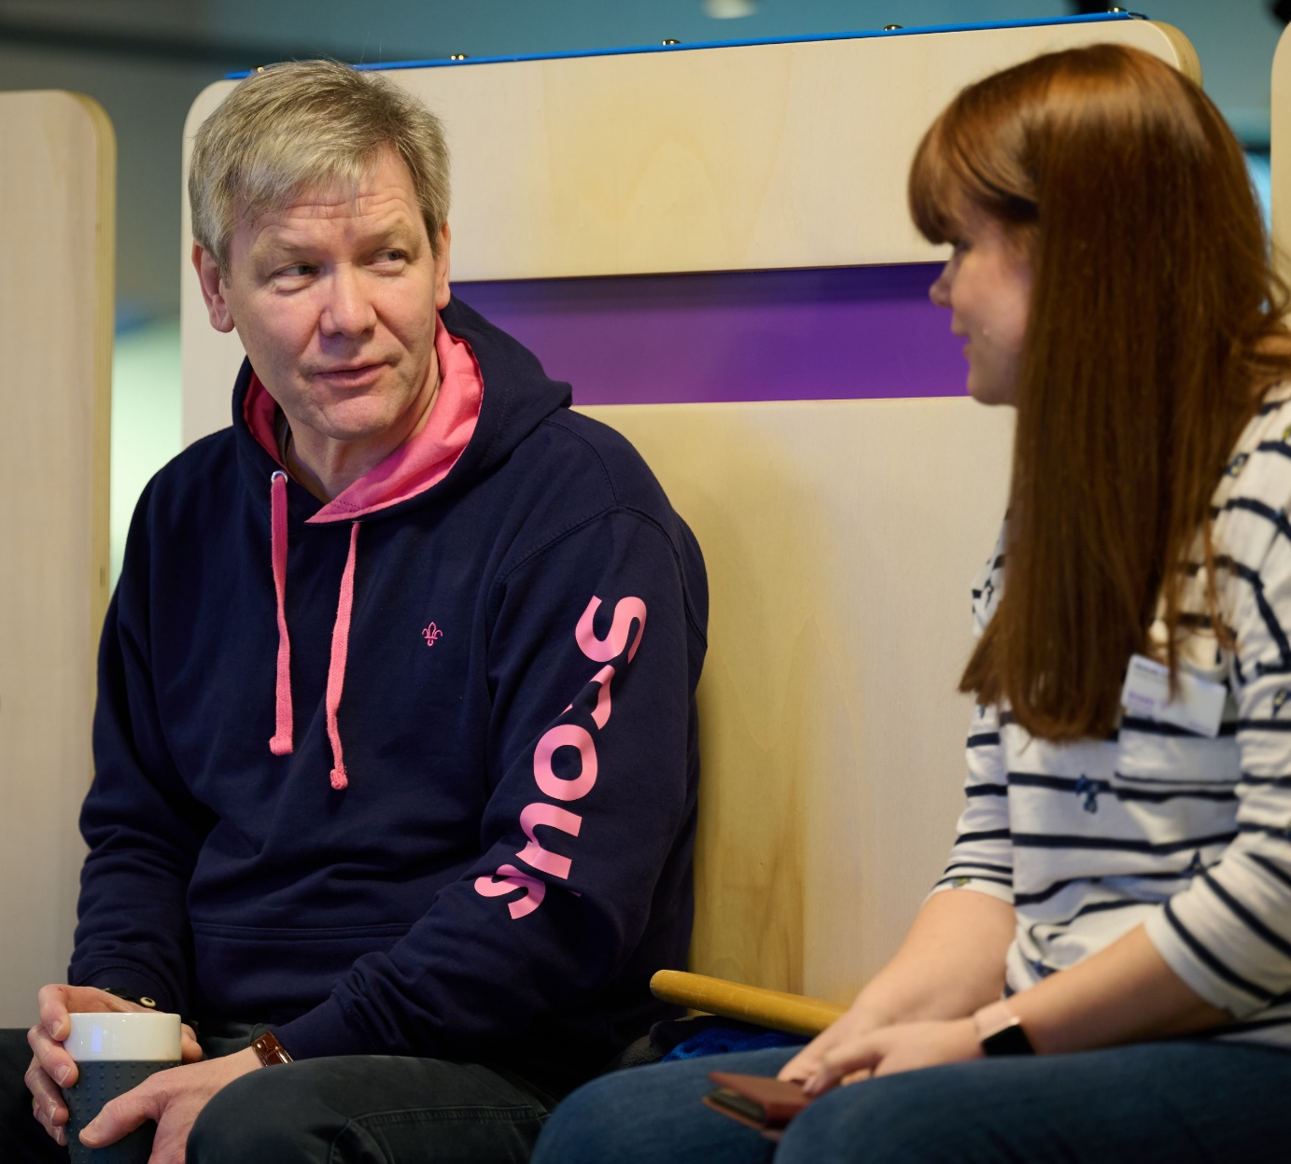
How we Volunteer Together
Adopting a team-based approach
This approach means:
It’s easier for new volunteers to join the team
We have clearer purpose and responsibilities
Volunteering is more flexible and suits people’s skills, interests, and time
Each team is led by a Team Leader(s) or Lead Volunteer(s)

Slide 37
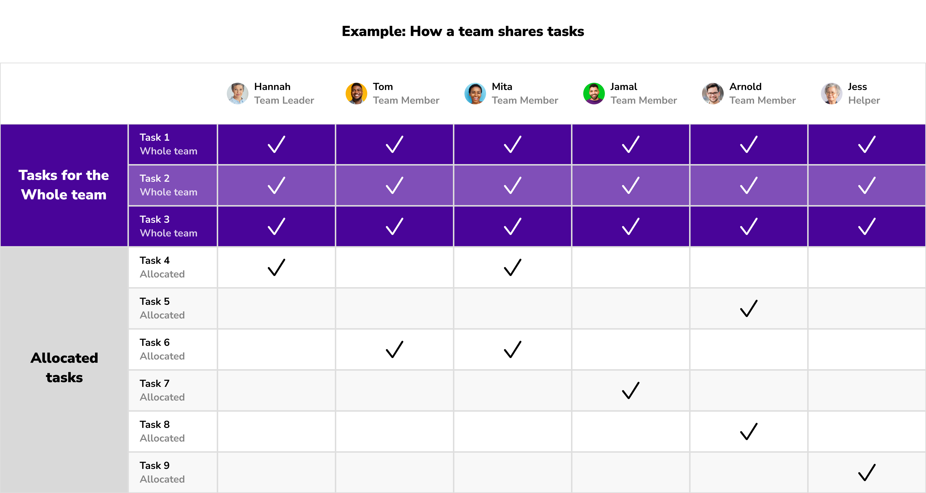
How we Volunteer Together
Adopting a team-based approach
How volunteers work in teams

Slide 38
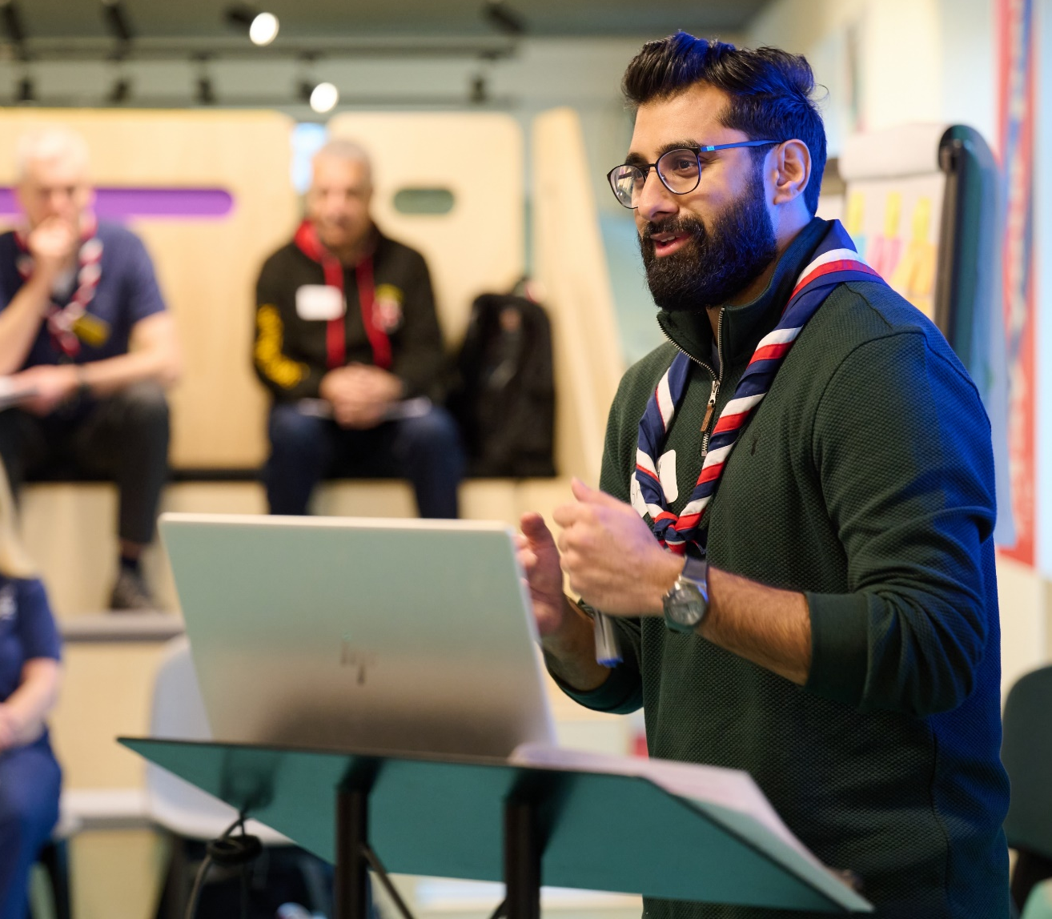
How we Volunteer Together
Adopting a team-based approach
Lead Volunteers & Team Leaders
Each team will have at least one Team Leader or Lead Volunteer
They work with Team Members to share tasks out and make sure the team runs smoothly, they are not responsible for doing all the tasks themselves
There may be multiple Lead Volunteers or Team Leaders in a team
They are responsible for;
Creating a positive team environment
Helping volunteer find what they need
Attracting and welcoming new volunteers into their teams as needed
Reflecting and Reviewing with the team

Slide 39
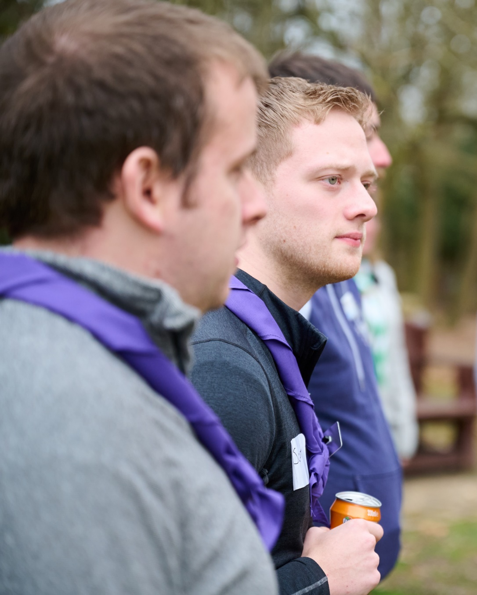
How we Volunteer Together
Adopting a team-based approach
Changes to our current teams
These changes to how we volunteer together, along with the wider volunteer experience changes will mean changes to our current teams and roles
We rely on the committed and passionate volunteers we have to make things happen across the whole movement
There’s a team for everyone in the new structure which will match to your experience, skills and interests

Slide 40
How we Volunteer Together
Adopting a team-based approach
Section Structure
Team Leader(s)
Team Member
Team Member
Section Team
Young Leader
Team Member
Young Leader

Slide 41
How we Volunteer Together
Adopting a team-based approach
Group Structure
Plan and deliver a safe programme
Make sure admin is done correctly
Communicate with others
Look after section finances
Sections
Group
Group Leadership Team
Trustee Board
Help the group’s sections to run well
Develop our volunteers and help recruit new ones
Engage with the community
Enable growth and new provision
Manage incidents
Support effective processes (e.g., admin, finance, equipment, etc.)
Look after the money
Ensure buildings and
equipment are in good working order
Manage a risk register
Make sure everyone follows legal requirements

Slide 42
How we Volunteer Together
Make sure all District teams work well
Make sure all teams are inclusive and reflective of the local community
Make sure safety and safeguarding responsibilities are fulfilled
Support the District Youth Lead to make sure decisions are shaped by young people
Adopting a team-based approach
Young Leaders
Explorers
District Structure
Look after the money
Ensure buildings and
equipment are in good working order
Manage a risk register
Make sure everyone follows legal requirements
Trustee Board
Leadership Team
14 - 24 Team
Network
14-24 Team, for their Sections
Support each Explorer, Young Leader and Scout Network section team
Attract and welcome new volunteers to Group and District teams
Make sure volunteers are well-supported
Make sure volunteers are recognised
District
Group Leadership Teams
Support each of their section teams
Develop our volunteers
Engage with the community
Enable growth and new provision
Manage incidents
Support effective processes
Volunteering Development Team
Groups
Help section teams run high-quality programmes
Facilitate programme networking opportunities
Provide access to specialist expertise
Manage approvals for activities and permits
Programme Team
Support Team
Engage with the local community
Grow sections and groups
Manage incidents
Manage administration, property and equipment
Full details are in each Team Description

Slide 43
How we Volunteer Together
Adopting a team-based approach
Sub-teams
Sub-teams are being introduced to help organise our volunteers and will sit within another team
Each sub-team will have a specific area of focus within the overall scope of the larger team
We can use sub-teams to:
Increase a sense of identity and belonging within volunteers
Make better use of volunteers’ time and resources
Help make it clearer what people do, and what they’re responsible for
For example, setting up a Hillwalking or Climbing Team within the Programme Team

Slide 44
How we Volunteer Together
Adopting a team-based approach
Accreditations
Sometimes, a person needs to be given permission to do a specific task, this is called an ‘accreditation’
Accreditations will be introduced along with the new digital systems
For Example:
A task that needs to be done with someone with specific skills or qualifications - A Kayak or Archery permit assessor
A task where someone needs to find and contact a specific person - The HQ Awards Team knowing who to post awards to

Slide 45
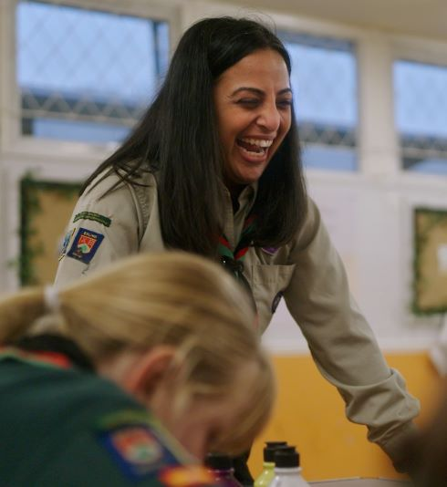
How we Volunteer Together
Adopting a team-based approach
Accreditations
Volunteers will need to meet the right criteria to receive an accreditation, for example:
Holding a certain qualification
Completed specific learning
Be in a particular role
Specific accreditations will be:
Adventurous Activity Assessor
Night Away Assessor
First Response Trainer
Manager of Activity Permit Scheme
And more!
These will all come alongside the launch of the digital systems

Slide 46
How we Volunteer Together
Adopting a team-based approach
District Structure
Jon Minshull
District Leadership Team -
Leads and inspires volunteers to give young people great experiences and skills for life. They make sure the teams in their District are organised, have enough volunteers, and can deliver a great programme.
Trustee Board -
Trustees make sure the charity is well-managed, risks are assessed and mitigated, buildings and equipment are in good working order, and everyone follows legal requirements and Policy, Organisation and Rules (POR)
14-24 Team -
Helps all volunteers in Explorer (including Young Leaders) and Network Sections. They help section teams plan and deliver great programmes for young people
Colin Sills
Nicky Dennison

Slide 47
How we Volunteer Together
Adopting a team-based approach
District Structure
Caroline Dugdale
Volunteering Development Team -
Makes sure all volunteers in their District have a positive and enjoyable volunteering experience. They make it easy for people to join and learn new skills.
Programme Team -
Helps every section in the District run a safe, enjoyable and high-quality programme. To help do this, they bring Section Team volunteers together with activity experts.
Support Team -
Provides the tools and resources to help Scouts run smoothly
Jan Townley
Ulric Schwela

Slide 48
Transforming our Volunteer Experience
A warmer welcome for everyone

Slide 49
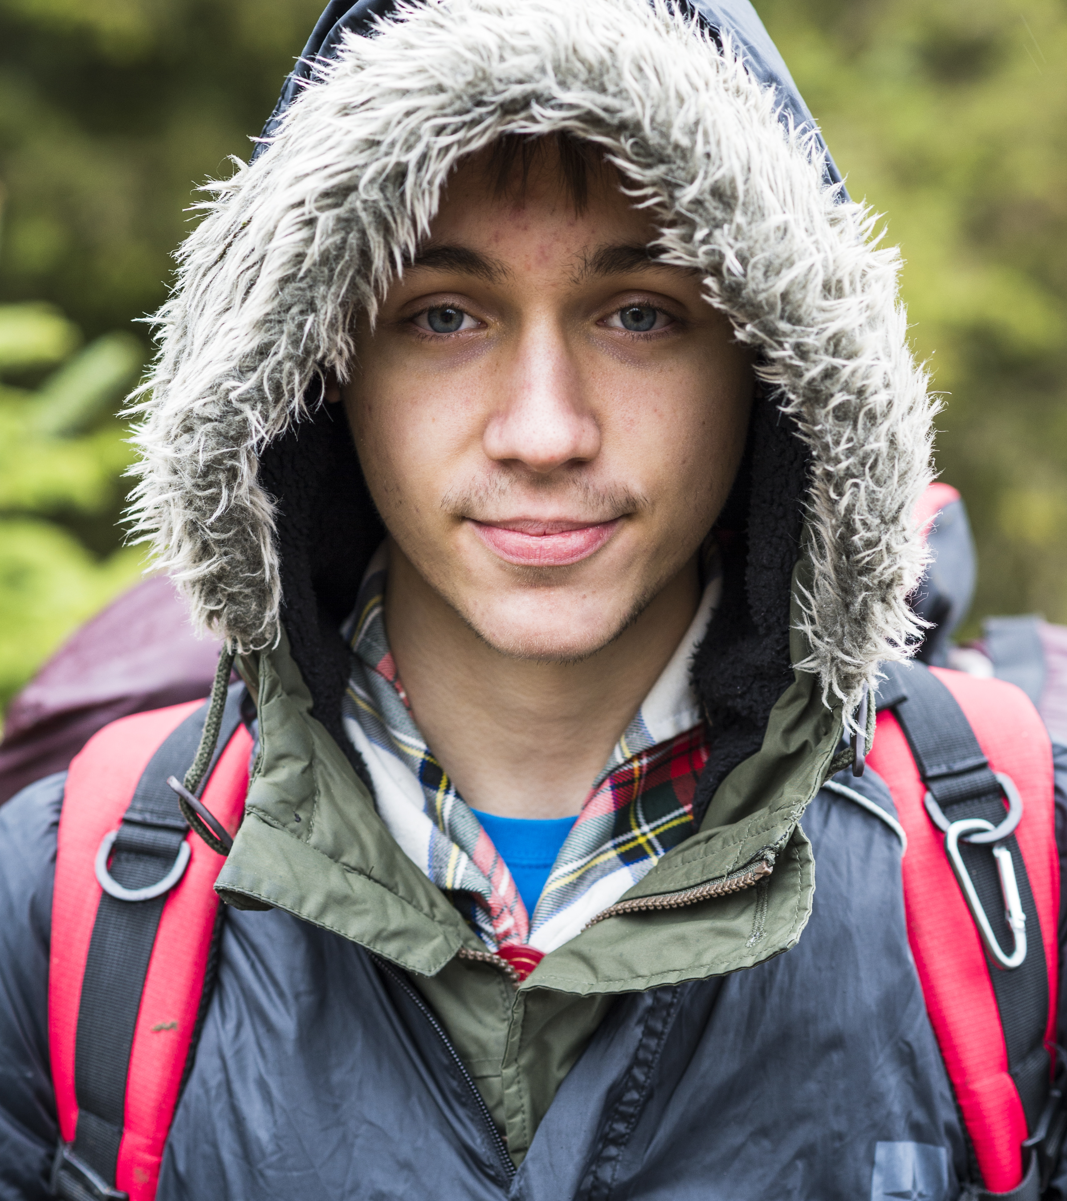
Transforming our Volunteer Experience
A warmer welcome for everyone
What have we learnt?
In our research with volunteers, we have learnt that:
Joining us can feel daunting for new volunteers
New volunteers feel like our appointments panels are more like a job interview
Appointments are time consuming and rely on inefficient tools and processes
We want more volunteers locally but need the support to make it happen
We’re often reliant on our existing networks to get new volunteers - Parents, Carers, Ex-Members and current volunteers…

Slide 50
Transforming our Volunteer Experience
A warmer welcome for everyone
What’s changing?
From | To
Intimidating appointments process and inefficient processes | Volunteers feel welcomed, value and at ease from day one
Appointments Panels - (Part of Appointments Advisory Committees) | Welcome conversation where you volunteer A buddy throughout your induction
Volunteers feeling unsupported when joining | Volunteers being provided with the information, key knowledge and skills required to ensure they can be successful in their role
Manual, time-consuming admin | New digital systems which: Reduce administration Have self-service and automated referencing Empower new volunteers
Reliance on existing networks to recruit | Capability to connect with popular apps and platforms, ensuring more people know about volunteering with Scouts

Slide 51
Transforming our Volunteer Experience
A warmer welcome for everyone
Digital systems supporting this change
New recruitment and attraction tools supporting this area of change will form part of the new digital systems. Features include:
Improved visibility of volunteering opportunities with easily shareable advertisements
Improved attraction of volunteers who have no previous experience of Scouting
Transparency for new volunteers, showing them each step of their recruitment journey
An automated and mobile friendly referencing system

Slide 52
Transforming our Volunteer Experience
More engaging learning

Slide 53
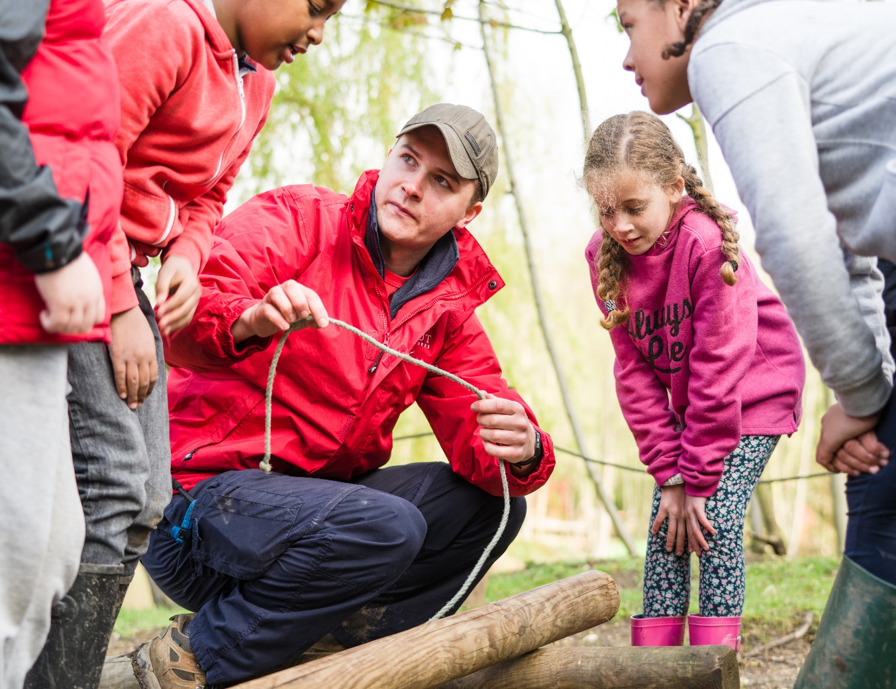
Transforming our Volunteer Experience
More engaging learning
What have we learnt?
In our research with volunteers, we have learnt that:
Our training scheme can feel overwhelming for new volunteers
Some learning is hard to access and requires finding more time available to attend
We don’t have enough training advisers to support learners this also delays validation which can be frustrating for the learner
The average length of time someone volunteers is 2 years, but nearly every volunteer role must complete the wood badge which can take up to 3 years to complete

Slide 54
Transforming our Volunteer Experience
More engaging learning
What’s changing?
From | To
‘Training’ and Training teams | Personalised learning when you need it, tailored to your role Support and management of learning built into our structures and digital systems
Time-consuming administration, managing multiple learners, compliance and validation | Existing skills recognised and sign off built in, no separate validation required New digital learning systems to support learners and reduce administration including easy to manage and report compliance
An off-putting digital learning experience | Digital first (but not digital only) approach, revitalised learning modules including bite sized learning, all in one place
Wood badge for almost every volunteer role | Wood badge is optional and available to all

Slide 55
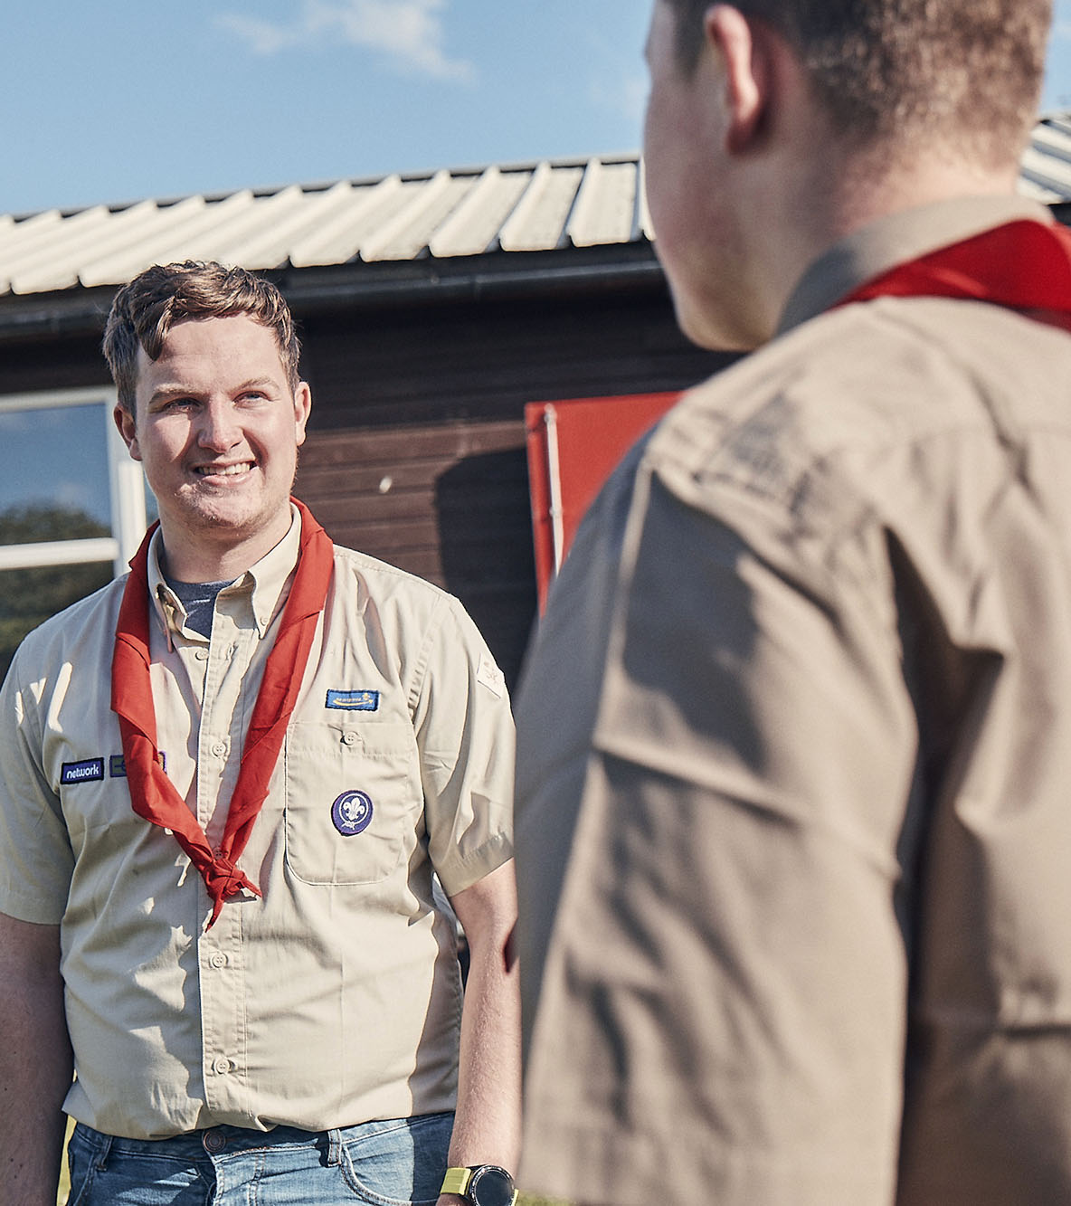
Transforming our Volunteer Experience
More engaging learning
Digital systems supporting this change
A new learning tool will form part of the new digital system supporting this change. Features include:
Learning accessible all in one place
Improved accessibility features and support for all
Easy reporting and management of learning, including compliance
Recognition of learning previously completed in Scouting
Updated and improved Core Learning

Slide 56
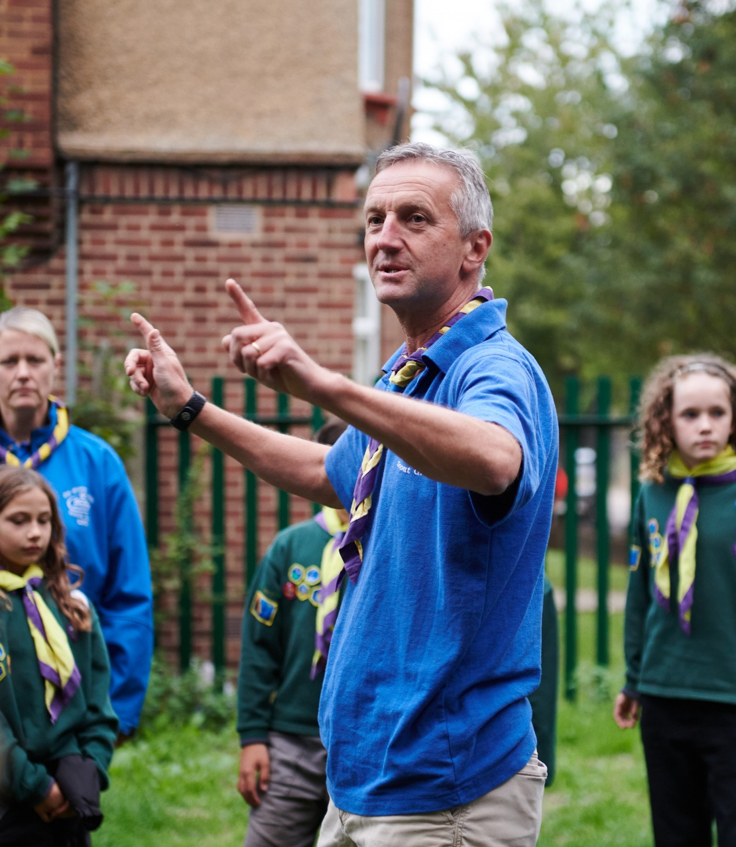
Engaging Learning
Growing Roots
Growing Roots
Growing Roots will become the new mandatory learning for our volunteers
Volunteers will have 6 months to complete their Growing Roots learning
Growing Roots will comprise of two parts;
The learning a volunteer needs to get started
The learning a volunteers needs for their team and role

Slide 57
Engaging Learning
Growing Roots
The learning everyone needs to get started
Data Protection in Scouts
Data breaches & deleting data
What we do & How we do it
Purpose and values
Creating Inclusion
Self-awareness
Safe Scouting
Storing & sharing data
Creating inclusive spaces
Supporting specific needs
Challenging bias and discrimination
E-Safety
Assessing and Managing risk
Incidents - respond and report
Mental Health Awareness
Safeguarding
Gathering data
Working with others
Running our programme (The basics)

Slide 58
Engaging Learning
Growing Roots
The learning a volunteer needs for their role
“Delivering a Great Programme”
Section Teams
“Leading Scout Volunteers”
Team Leaders, Lead Volunteers
“Being a Trustee in Scouts”
Trustees
How to work with parents/guardians
How to actively involve young people
Running our programme (In practice)
Teamwork, inclusion and conflict from a management perspective
Charity regulator processes
Suspensions, sanctions and difficult conversations
Insurance, legal responsibilities (Inc. GDPR), equality impact assessments
Trustee Responsibilities

Slide 59
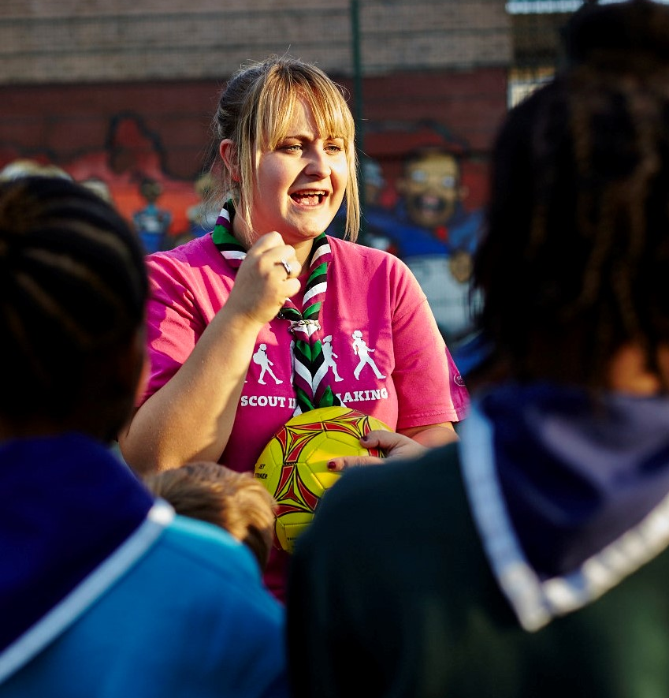
Engaging Learning
Branching Out
Branching Out
Branching Out will form the learning you can take on beyond Growing Roots
It will be delivered through a variety of methods including digital, face-to-face and blended models
Some current training modules will keep running for a while, as we work to update or replace them and add more new content.
This suite of new learning will become available over the course of 2024-2025 and will be updated and added to on an ongoing basis after that

Slide 60
Engaging Learning
Branching Out
Manager & Supporter Training
Beyond the learning in Growing Roots, manager and supporter training will also become optional
For those that choose to complete this it will continue to be delivered in its current form
These will be reviewed and refreshed or replaced along with the other remaining modules to form part of the Branching Out learning
This will take place over the next 18-24 months, with the updated learning being released during 2025

Slide 61
Engaging Learning
Wood Badge
Changing the Wood Badge
As part of improving the learning experience we’ll be moving to an optional Wood Badge
Every volunteer will be able to decide what learning will be most beneficial to them to earn their Wood Badge and whether they want to do a Wood Badge at all
You won’t be required to repeat any learning when you change teams or roles
The Wood Badge changes will come in two stages:
A transitional Wood Badge while the current modules are reviewed
A new Wood Badge launched during 2025
More information will be shared about what this looks like later in 2023

Slide 62
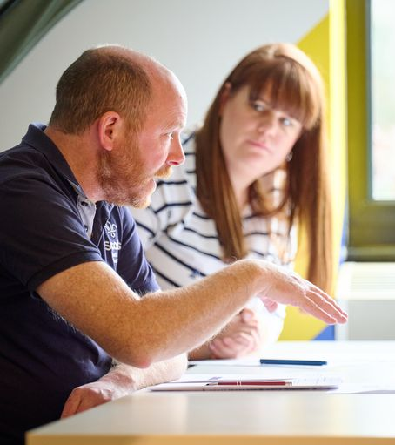
How we Volunteer Together
Our Volunteering Culture
Our Volunteering Culture
Our Values describe Scouting at its best, while Our Volunteering Culture is how we make our best a daily reality. It sets out:
What to expect from UK Scouts
What is expected as a volunteer
What we’ll work together to do
It guides and reminds us of our goal, both as a movement and as a volunteer team: to help more young people gain Skills for Life
It's there to help our volunteers thrive from the moment they join, giving them clear expectations and a shared understanding of what it really means to be a volunteer in Scouts

Slide 63


Slide 64
  Go-Live Timeline
Early Adopters
Will start using the new digital tools, processes and structures from middle of February 2024
Counties must please update Compass information by 15 January (exact dates to be confirmed)
All Counties
Will start using the new digital tools, processes and structures from end of April 2024
Counties must please update Compass information by 31 March (exact dates to be confirmed)

Slide 65
  Being prepared
Are your details correct on compass?
Do you have a unique personal email address on compass?
Is your training/validation up-to-date?
Do you know how your role maps to the new structure and which team you will be part of?

Slide 66
  Thank you

